Slide 1
Body and Integration Research the primary symptom into the care of psychosis
Dr Anna Franziska D’Albenzio
Dr Annarita Acunzo
Notes:
il lavoro sul corpo nella cura della psicosi

Slide 2
Body and Integration Research the primary symptom into the care of the psychosis
1. Theoretical introduction to the psychopathological models and to the concept of psychosis
2. Favorable and unfavorable elements to the prognosis: two psychotic sibling
3. Body work in treatment of mental illness/psychosis

Slide 3
This work contains videos with real patients
We have permission to use the video material
only in scientific contexts
It is recommended not to make audio or and video recordings

Slide 4
1. Theoretical introduction to the psychopathological models and to the concept of psychosis
1.1 Psychiatric Model
1.2 Janet’s Model
1.3 Psychiatric Model Today
1.4 Integrated Structural Model

Slide 5
Every clinical steatment is based on an epistemological view
Body and Integration Research the primary symptom into the care of the psychosis

Slide 6
FOUNDATION
Body and Integration Research the primary symptom into the care of the psychosis

Slide 7
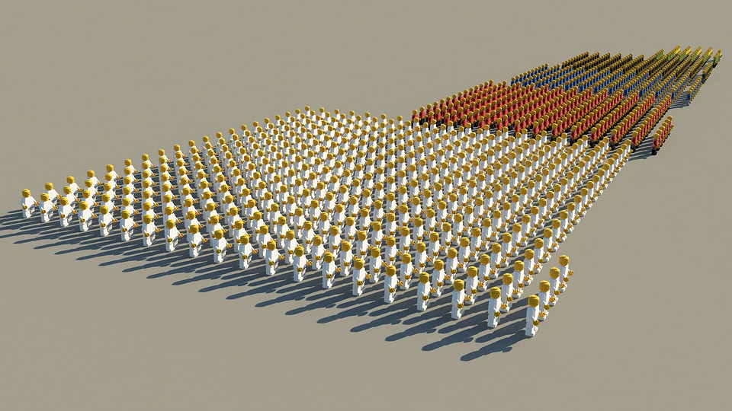
ANGLO-SAXON PSYCHIATRY (DSM5/ICD 10) Atomistic view
Psychiatric Model

Slide 8
Epistemological view
Reality exists and is made of Atoms
Body and Integration Research the primary symptom into the care of the psychosis

Slide 9
Symptoms, Functions and Subfunctions
Symptoms
Functions
Subfunctions
Body and Integration Research the primary symptom into the care of the psychosis

Slide 10
Atomistic View = Category
Cognitive
Function
Vegetative Function
Affective
Function
PsychomotorFunction
Symptoms
Symptoms
Symptoms
Symptoms
Body and Integration Research the primary symptom into the care of the psychosis

Slide 11
FUNCTIONS
SUB-FUNCTIONS
COGNITIVE
Alertness and level of consciousness; Orientation; Thought’s content and form; Attention; Memory; Perception; Judgment ability
SYMPTOMS
AFFECTIVE
Feelings (sadness, anguish, moral pain, fear, anxiety, stress, distress, anger, euphoria), stability, instability
SYMPTOMS
I
LLNESS
PSYCHOMOTOR/
BEHAVIORAL
Proprioception; Appearance (weight, clothes and care, age); Motor activity (gait and posturre); Facial expression; Speech; Attitude toward eaach other; Impulse control
SYMPTOMS
VEGETATIVE
Circadian rhythm, Nutrition, Sexuality
SYMPTOMS
Body and Integration Research the primary symptom into the care of the psychosis

Slide 12
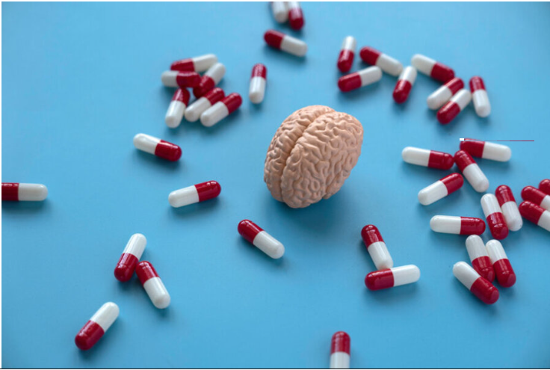
Psychosis
a serious loss of contact with reality with biological alterations of cognitive and affective functions and sub-functions and serious impairment of psychomotor and behavioral skills.
Body and Integration Research the primary symptom into the care of the psychosis

Slide 13
1
Symptoms are the results of alterations in a specific function and subfunction
2
Lack of integration and hierarchy among functions
3
Biological and psycological levels are contaminated: biological level explains the psycological level
Body and Integration Research the primary symptom into the care of the psychosis

Slide 14
Intervention
QUANTITATIVE CHANGE
Elimination/Reduction
of symptoms
RESTORATION OF PREVIUOS BALANCE
with reduced capacity
STABILITY
Body and Integration Research the primary symptom into the care of the psychosis

Slide 15
TREATMENTS
Pharmacotherapy
to riduce symptoms
Sociotherapy/
Occupational therapy
to restore previous ability
Supportive Psychotherapy
for families and to stabilize the patient to live with mental illness
Body and Integration Research the primary symptom into the care of the psychosis

Slide 16
EUROPEAN PSYCHIATRY
FROM ATOMISM
TO PRE-SUBJECTIVE STRUCTURALISM:
PIERRE JANET
Janet’s Model

Slide 17
Epistemological view
Reality exists and is made of structures
Body and Integration Research the primary symptom into the care of the psychosis

Slide 18
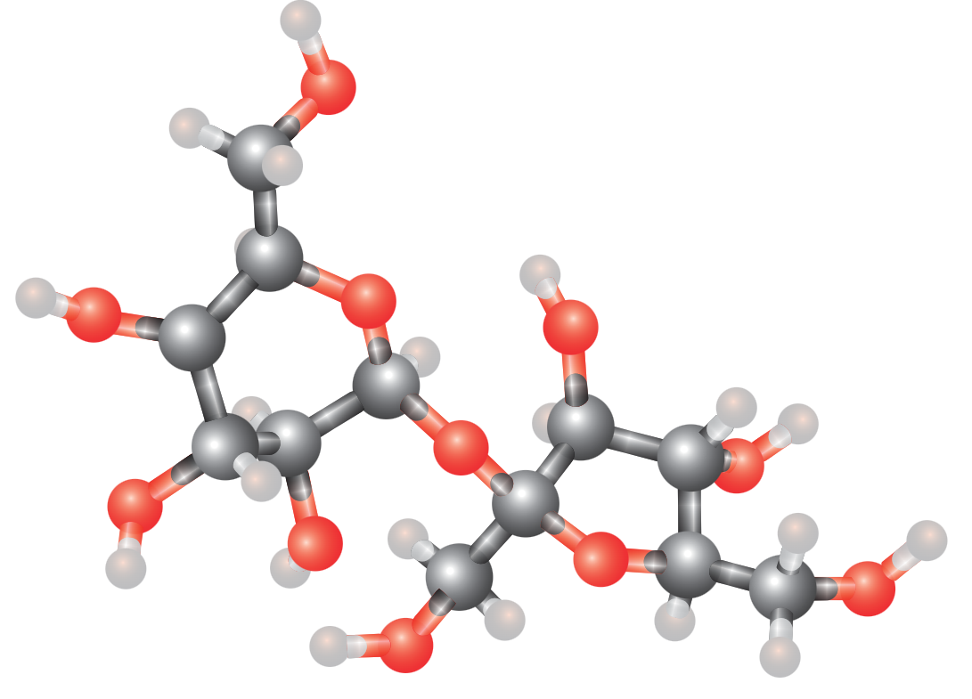
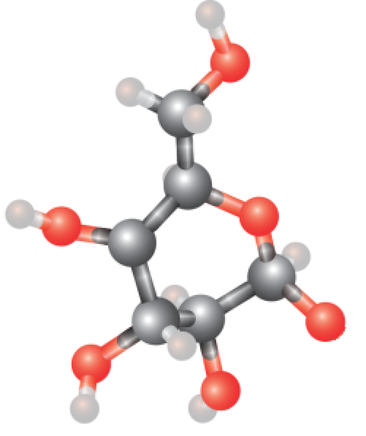
Janet 1889
Life is a constant activity of integrating increasingly complex psychological automatisms (units)
Balanced relationship between psychological strength (parts) and the psychological tension (way of organizing the parts)
Body and Integration Research the primary symptom into the care of the psychosis

Slide 19
Mental illness
From complex automatisms to partial automatisms
DESAGREGATION
Failure to synthesize partial cognitive, imaginative, emotional, muscular automatisms, which remain fragments without a coherent unitary organization
Body and Integration Research the primary symptom into the care of the psychosis

Slide 20
TREATMENT MODEL
1: To stabilize and riduce symptoms: Pharmacotherapy
2: Traumatic memories treatment: Psychotherapy
3: Integration of the whole personality: with the dissociation resolution and the promotion of future personality development
Psychiatric Model
Psicoanalitic model Cognitive-behavioral model
Integrated Structural Model Precursor
Body and Integration Research the primary symptom into the care of the psychosis

Slide 21
TREATMENT
Psychotherapy
Discover fixed ideas
Resolve dissociation
Increase psychological tension = restructure with training
Pharmacotherapy
to riduce symptoms
Body and Integration Research the primary symptom into the care of the psychosis

Slide 22
The struggle to become structuralist
Psychiatric Model Today

Slide 23
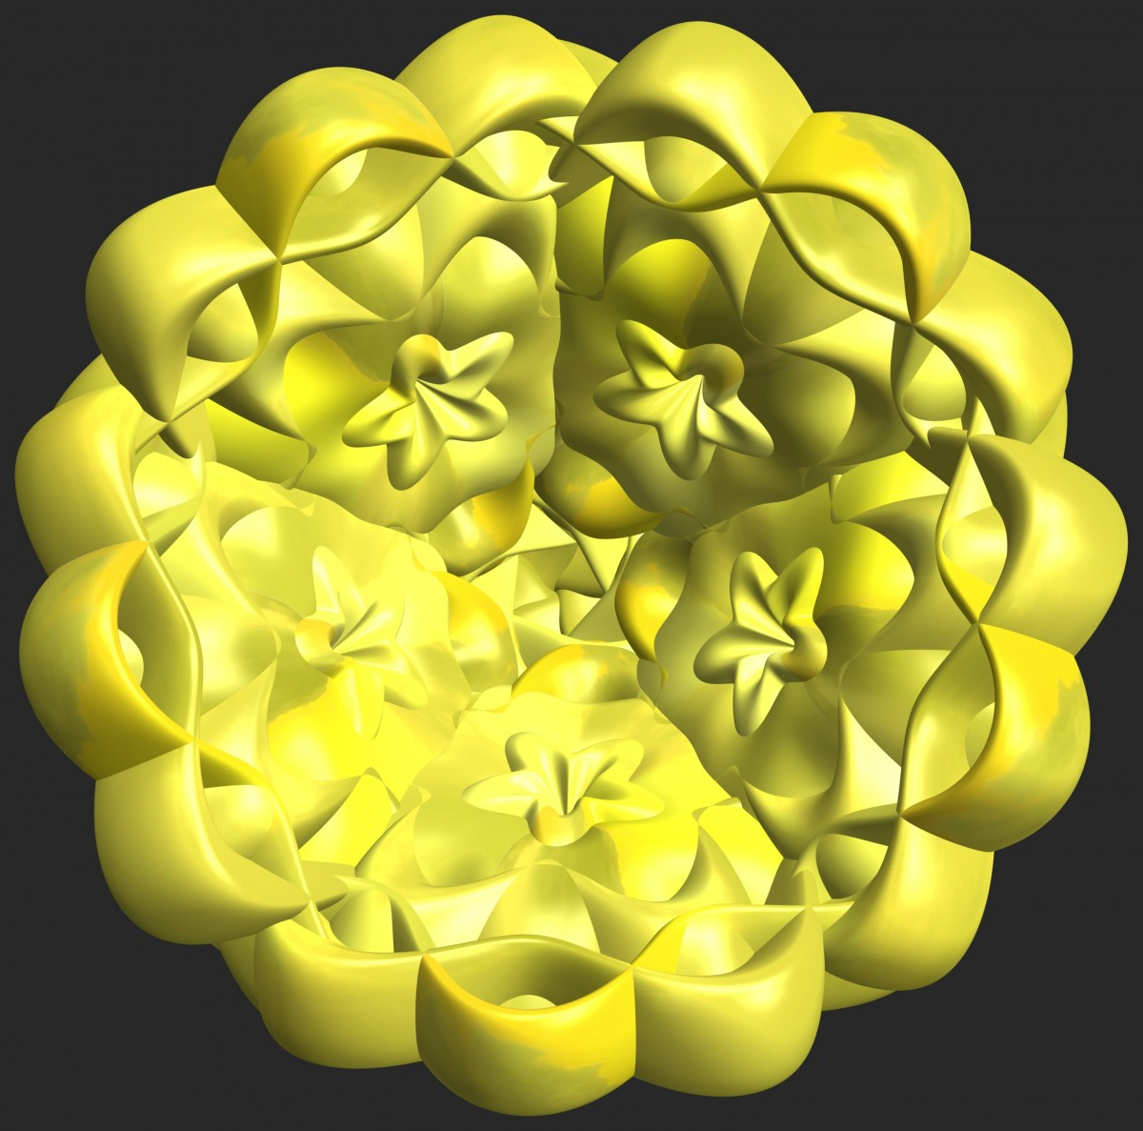
Epistemological view
Reality exists and is made of Atoms
Reality exists and is made of Structures
Body and Integration Research the primary symptom into the care of the psychosis

Slide 24
A leap between past…. (BLEULER)
STRUCTURATED DELIRIUM
(PARANOIA)
RIGID DEDUCTIVE THINKING
PRIMARY
SYMPTOM
COGNITIVE
FUNCTION
SCHIZOPHRENIC
DELIRIUM
INDUCTIVE THINKING
Body and Integration Research the primary symptom into the care of the psychosis

Slide 25
...and present
“NUCLEAR”
SYMPTOMS
PERIPHERAL
SYMPTOMS
PRIMARY
SYMPTOMS
SECONDARY
SYMPTOMS
Body and Integration Research the primary symptom into the care of the psychosis

Slide 26
STRUCTURATED
DELIRIUM
(PARANOIA)
Suspiciousness, irritable mood, anger or depressed, hypervigilance....
DISORGANIZED
DELIRIUM
(SCHIZOPHRENIC)
Hallucinations, Disorganized behavior, Negative symptoms, Despair, Anguish
Primary Symptoms
Secondary Symptoms
Body and Integration Research the primary symptom into the care of the psychosis

Slide 27
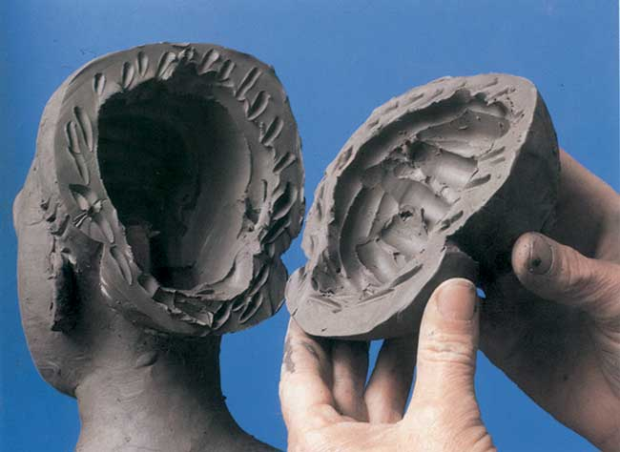
Primary symptoms in severity order
SCHIZOPHRENIC
DELIRIUM
STRUCTURATED
DELIRIUM
(PARANOIA)
Body and Integration Research the primary symptom into the care of the psychosis

Slide 28
FROM PRE-SUBJECTIVE STRUCTURE TO INTERSUBJECTIVE STRUCTURE From functions to languages
Integrated Structural Model

Slide 29
ATOMS
STRUCTURES
Body and Integration Research the primary symptom into the care of the psychosis

Slide 30
Epistemological view
Structural Costructivism
Reality is not given, but it is built into structures
Evoluzionist Emergencyist
From - comes +. E.g. :life is born from non-life
Intersubjective
Reality comes from the meeting between two responsible subjects
Body and Integration Research the primary symptom into the care of the psychosis

Slide 31
Key words: anthropology, anthropopathology, therapy
LANGUAGE
POSTULATES
INTEGRATION
TREATMENT
DISSOCIATION
Body and Integration Research the primary symptom into the care of the psychosis

Slide 32
LANGUAGE
Coherent connection (syntax)
between elements (syllables, words, statements)
to obtain a communicable meaning
verbally or non-verbally
Body and Integration Research the primary symptom into the care of the psychosis

Slide 33
Denote
Language
Connote
Give a name to give
life with
a subjective meaning
Give a subjective judgement
Verbal
Denote
and
Connote
Pre-Verbal
Denote
and
Connote
Language is a grammar
Ra
Fa
E
Bo
Body and Integration Research the primary symptom into the care of the psychosis

Slide 34
Fa
Fantastic
4 “EXISTENCIAL LANGUAGES”
4
LANGUAGES
Ra
Rational
E
Emotional
EACH SUBJECT IS IN THE WORLD
WITH HIS BODY, HIS EMOTIONS, HIS FANTASIES AND HIS RATIONALITY
SUBJECT EXISTS BY THESE 4 LANGUAGES
Bo
Body
Body and Integration Research the primary symptom into the care of the psychosis

Slide 35
SUBJECT IS MADE BY 4 LANGUAGES
Fa
SUBJCTIVE
GRAMMAR
Ra
E
Every language is integrated with others languages to build a more complex subjective grammar
Bo
Body and Integration Research the primary symptom into the care of the psychosis

Slide 36
Existential positions
They describe different relationships between subject and each other:
Child: subject is inclined to satisfy his needs
Parent: subject’s ability is to take care of each other’s growth
Adult: subject’s ability is to do what he believes is right for himself and others
Healthy subject is able to use these positions according to the moment of his life and the type of relationships where is in
P
A
C
Ra
Fa
E
Bo
Body and Integration Research the primary symptom into the care of the psychosis

Slide 37
EVERY LANGUAGE CAN BE:
OR
SR
SS
CONCIOUS
UNCONCIOUS
SPEECH
- Unconcious (Spontaneous) speak correctly
- Concious (Self-consciousness) grammatic rules knowledge
BODY LANGUAGE
- Unconcious (Spontaneous) postures, needs and automatic gestures
- Concious (Self-consciousness) grammatic needs knowledge
Body and Integration Research the primary symptom into the care of the psychosis

Slide 38
SELF
TOTALITY
LIFE CHAIN RINGS
THE SUBJECT IS A LANGUAGE
WHO GIVES AND RECEIVES MEANING
SS
SR
EN
ISC
EXISTENCIAL POSITION
P
A
C
EXISTENCIAL LANGUAGES
Ra
Fa
E
Bo
Body and Integration Research the primary symptom into the care of the psychosis

Slide 39
POSTULATE
Automatic rules’s a person, a family, a culture about what think is good or bad, right or wrong. They could be changed when become reflection’s object.
Body and Integration Research the primary symptom into the care of the psychosis

Slide 40
INTEGRATION
DISSOCIATION
Connection among coherent elements
Break connection for incoherence among elements
Body and Integration Research the primary symptom into the care of the psychosis

Slide 41
Lack of integration for incoherence among languages or inside languages
SYMPTOM
PSYCHOSIS
Subject tries to keep elements together (existencial languages), even if they are incoherent/dissociated, without changing its structure
TREATMENT
Build necessary coherence to the possible integration
Body and Integration Research the primary symptom into the care of the psychosis

Slide 42
Intervention
DIAGNOSIS:
Languages and their elements presence or absense.
Integration or dissociation between them
Quantitative Change
=
Balance Break
New balance/
New stability
Qualitative
Change
Body and Integration Research the primary symptom into the care of the psychosis

Slide 43
TREATMENTS
Integrated Structural Psychotherapy
to solve problems ever more complex changing subject structure
Sociotherapy
to stabilize the acquired skills and to create new problems
Pharmacotherapy
to support psychotherapy to reduce suffering
Body and Integration Research the primary symptom into the care of the psychosis

Slide 44
2. Favorable and unfavorable elements to the prognosis: two psychotic siblings
2.1 Anamnesis
According to psychiatric model
According to integrated structural model
Clinic cases
2.2 Diagnosis
Symptoms
Clinic cases
Diagnosis according to psychiatric model
Diagnosis according to integrated structural model
2.3 Prognosis
According to psychiatric model
According to integrated structural model
Anamnestic elements for prognostic prediction
2.4 Treatments
According to psychiatric model
According to integrated structural model
Clinic cases

Slide 45
Palmira and Roberto at the start of journey
July ‘19
February ‘20
Foto dei pazienti e non autorizzati alla pubblicazione
Year of birth: 1995
Year of birth: 1992
Body and Integration Research the primary symptom into the care of the psychosis

Slide 46
CLINICAL HISTORY OF A TEST SUBJECT, COLLECTED DIRECTLY OR INDIRECTLY BY THE DOCTOR AS A KEY ELEMENT IN THE FORMULATION OF THE DIAGNOSIS
Anamnesis

Slide 47
THE ANAMNESIS ACCORDING TO
THE PSYCHIATRIC MODEL
History
of symptoms
To identify behavioral manifations (signes) and symptoms
The purpose is to understand which equilibrium has been broken,and how to rebuild.
That lead to a specific disease.
Body and Integration Research the primary symptom into the care of the psychosis

Slide 48
THE ANAMNESIS ACCORDING TO INTEGRATED STRUCTURAL MODEL
History of the relationships with oneself and others
Which are the repeating strucutures (Relational rules). It consents to comprehend the patient’s automatic functioning (Spontaneous)
It will be became the object of the consideration, to be modified, if it’s disfunctional
(Reflection)
Body and Integration Research the primary symptom into the care of the psychosis

Slide 49
ANAMNESIS OF PALMIRA’S LIFE CYCLE
 | 0-3 Years old | Normal birth and physiological development.
 | 3-6 Years old | She attendend a private kinder garten; there where no relationship with her peers. She has a stable relationship with her mother.
 | 6-10 Years old | A private elementary school. Learning difficulties due to she needs a special education teacher. Despite everything, she liked studying. Peer relationship were absent; she had a symbiotic relationship with her mother, who spoiled her. During this period her mother shows depressive symptoms. Palmira spends the main part of her time by herself. She often spends the entire day in bed.
 | 10-14 Years old | Low-performing secondary school. Social isolation. She mostly spent her time with her mother or her pets.
 | 14-20 Years old | Private High school (Hospitality Institute). She interrupts her studies. Social isolation with everybody but her mother.
Body and Integration Research the primary symptom into the care of the psychosis

Slide 50
PALMIRA’S PSYCHOPATOLOGICAL ANAMNESIS
 | 2009 14 Years old | Social withdrawal: she starts psychotherapy in couple with her mother.
 | 2013 18 Years old | Hearly-onset psychotic episodes: auditory and visual hallucinations. Farmacological therapy: not specified antidepressant (by her family); she after changes it with Abilify.
 | 2015 20 Years old | Aggressive Acting-outs’s Intensification. Farmacological therapy: Carbolithium e Depakin.
 | 2017 22 Years old | Attempted sucide by defenestration. First hospitalization in a psychiatric mental health hopsital. Farmacological therapy: Abilify, Mutabon e Tegretol
 | 2018 23 Years old | Aggressive acting-outs toward her mother. A new hospitalization in a mental health hospital. Farmacological therapy: Haldol; Daparox; Tranquirit.
 | 2019 24 Years old | Aggressive acting-outs’s flare-ups toward other people. Taken over by the public health care. Farmacological therapy: Depakin chrono; Haldol; Rivotril. Hospitalization at «Kairos» (nursing home), because she was to unmanageable at home.
Body and Integration Research the primary symptom into the care of the psychosis

Slide 51
ANAMNESIS OF ROBERTO’S LIFE CYCLE
 | 0-3 Years old | Normal physiological development
 | 3-6 Years old | Shy and obedient child. When his sister was born, he was jealous, but as children he took care of her. He was often harassed by his older brother.
 | 6-10 Years old | He attended a private elementary school. He had attention problems, so he was followed by a private after-school.
 | 10-14 Years old | In secondary school, he met two friends, with whom he spent his afternoons on the street. He was often involved in disputes between his mother and his father’s family, during which his paternal grandfather often beat or mistreated him. He often defected to school. He got his lower secondary school diploma He used cannabis with his brother.
 | 14-20 Years old | Critical steps: 1- from school to work 2- from work with the father and brother to work with the employer
Body and Integration Research the primary symptom into the care of the psychosis

Slide 52
ROBERTO’S PSYCHOPATOLOGICAL ANAMNESIS
 | 2012 20 years old | EARLY SIGNS OF DECOMPENSATION: erotomaniac delirium related to the sister-in-law. Roberto is removed, he works elsewhere. He does not take psychotropic drugs.
 | 2016 24 years old | PSYCHOTIC ONSET Symptoms: Insomnia; persecution delirium; heterodirect aggression (he threatens neighbours with a chainsaw). Drug therapy: Valproic Acid and Risperidone. He suspends drug therapy by himself. Cannabis and cocaine use. Drug administration, without his knowledge : Delorazepam and Haloperidol.
 | 2018 26 years old | Difficulty in keeping the job stable. Symptoms: lack of energy, difficulty in concentration.. Pharmacological treatment at the public health service: Monthly vial of Paliperidone Palmitato. Social withdrawal appears and he leaves work.
 | 2019 27 years old | July 2019: he participates in family psychotherapy, at Kairos psychiatric residence, where his sister Palmira is admitted.
 | 2020 28 years old | February 2020: Admission to the Kairos Psychiatric Residence.
Body and Integration Research the primary symptom into the care of the psychosis

Slide 53
PROCEDURE CONSISTING IN THE INTERPRETATION OF SIGNS AND SYMPTOMS COLLECTED AS EXPRESSION OF A PATHOLOGICAL PROCESS
Diagnosis

Slide 54
Psychiatric
model
Manifestation of the malfunction of functions and sub-functions
The symptoms coincides with the desease
Symptom
Process of desease
Integrated
structural
model
Attempt to keep a balance
Symptom
Process of recovery
Body and Integration Research the primary symptom into the care of the psychosis

Slide 55
An exuberant girl
Video non autorizzato alla pubblicazione
ENERGY
STRUCTURE
Body and Integration Research the primary symptom into the care of the psychosis

Slide 56
«O’ BABBASONE»: is a Neapolitan word referred to a simple person who doesn’t look very smart
Video non autorizzato alla pubblicazione
ENERGY
STRUCTURE
Body and Integration Research the primary symptom into the care of the psychosis

Slide 57
Psychiatric Model
DSM-5
Integrated structural
model
Foto paziente P. non autorizzati alla pubblicazione
DISORGANIZED SCHIZOPHRENIA
DISSOCIATIVE PSYCHOSIS CONSIDERED “BLACK”
SCHIZOAFFECTIVE DISORDER IN COMORBIDITY WITH ABUSE OF DRUGS (CANNABIS AND COCAINE)
Foto paziente R. non autorizzati alla pubblicazione
DISSOCIATIVE PSYCHOSIS CONSIDERED “BLACK”
Body and Integration Research the primary symptom into the care of the psychosis

Slide 58
PALMIRA’S DIAGNOSIS IN THE PSYCHIATRIC MODEL
COGNITIVE
- Inductive delirium (Schizophenic)
- Hallucinations
F
U
N
C
T
I
O
N
S
S
Y
M
P
T
O
M
S
AFFECTIVE
- Emotional instability
PSYCHOMOTOR
- Aggressive and psychomotor agitation
- Social withdrawal and relational closure
VEGETATIVE
- Hyperphagia
Body and Integration Research the primary symptom into the care of the psychosis

Slide 59
PALMIRA’S DIAGNOSIS INTO THE INTEGRATED STRUCTURAL MODEL
Dissociative psychosis considered “black”
ENERGY
STRUCTURE
Body and Integration Research the primary symptom into the care of the psychosis

Slide 60
PALMIRA’S DIAGNOSIS INTO THE INTEGRATED STRUCTURAL MODEL
RA and FA are poor and
undefferentiated among themselves and dissociate
from E and BO.
Ra
Ra
L
ANGUAG
E
S
When the stimulus grows, energy in E and BO also grows.
The incoherence
between
RA and FA
doesn’t allow the denotation and connotation of
what is happening.
Fa
Fa
E
E
E and BO are rich languages and integrated among themselves
Bo
Bo
Body and Integration Research the primary symptom into the care of the psychosis

Slide 61
ROBERTO’S DIAGNOSIS IN THE PSYCHIATRIC MODEL
COGNITIVE
- Deductive delirium (Paranoia)
- Hallucinations
F
U
N
C
T
I
O
N
S
S
Y
M
P
T
O
M
S
AFFECTIVE
- Emotional instability
PSYCHOMOTOR
- Aggressive and psychomotor agitation
- Social withdrawal and relational closure
-Abuse of drugs
VEGETATIVE
- Insomnia
Body and Integration Research the primary symptom into the care of the psychosis

Slide 62
ROBERTO’S DIAGNOSIS IN THE PSYCHIATRIC MODEL
Dissociative psychosis considered “black”
ENERGY
STRUCTURE
Body and Integration Research the primary symptom into the care of the psychosis

Slide 63
PALMIRA’S DIAGNOSIS INTO THE INTEGRATED STRUCTURAL MODEL
RA an FA
are dominant
with an egocentric program,
dissociated from
E and BO
Ra
Ra
L
ANGUAG
E
S
Fa
Fa
When stimulus increase, the inconsistency among language makes it impossible to denote and connote new elements
E
E
E and BO languges are recessive languages, even if larger.
Bo
Bo
Body and Integration Research the primary symptom into the care of the psychosis

Slide 64
IN BOTH PALMIRA AND ROBERTO, THE SEVERE INCOHERENCE AMONG LANGUAGES AND INSIDE THE LANGUAGES (SPONTANEOUS SYMBOLIC) AVOIDS THE BIRTH OF THE SELF-CONSCIOUSNESS (SYMBOLIC REFLECT) AND JUSTIFIES THE DIFFERENT SYMPTOMATOLOGY

Slide 65
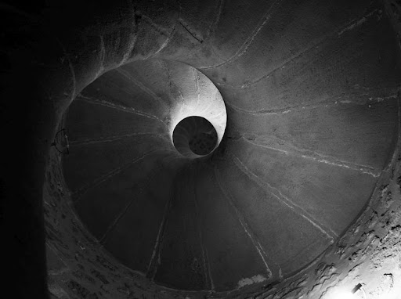
PREDICTION OF
DISEASE COURSE
AND OUTCOME
Prognosis

Slide 66
Factors influencing prognosis in the psychiatric model
Dsm-5
«Predisposing, precipitating, perpetuating and protective factors» and «course» (e.g. partial, complete, recurrent) remission).
Temperamental factors
Pre-existing mental illness
Genetic and physiological factors
Environmental factors (e.g. late winter/early spring in some locations)
Risk of suicide
Editor of the course (when there are pre-existing medical diseases)
Absence of
RELATIONAL FACTORS
?
Body and Integration Research the primary symptom into the care of the psychosis

Slide 67
Factors influencing prognosis in the integrated structural model
SEVERITY
RESOURCES
Body and Integration Research the primary symptom into the care of the psychosis

Slide 68
Factors influencing prognosis in the integrated structural model
SS- SR
EXISTENTIAL POSITION
LANGUAGES
SEVERITY
INTER SUBJECTIVITY
PRESENCE/ABSENCE OF THE OTHER
+++
DECISION
++
NEED FOR BOND:USE /RESPECT
PPRESENCE\ ABSENCE
CCONNECTION: INTEGRATION\
DISSOCIATION
+
Body and Integration Research the primary symptom into the care of the psychosis

Slide 69
Factors influencing prognosis in the integrated structural model
PATIENT (INDIVIDUAL-FAMILY)
PUBLIC HEALTH SERVICE
COMMUNITY (its constituent entities)
RESOURCES
=
DECISION ON THE BASIS OF
MAJORITY RULE
Body and Integration Research the primary symptom into the care of the psychosis

Slide 70
Factors influencing prognosis in the integrated structural model
PALMIRA
ROBERTO
DEPRIVED CHILD
NEED FOR RELATIONS
SHE LIKES STUDYING
SYMBIOTIC RELATIONSHIP WITH THE MOTHER WHO PLEASES HER NOT TO HAVE PROBLEMS
INDUCTIVE DELUSION
- SHY AND OBEDIENT CHILD
- NEED FOR RELATIONSHIP BASED ON REPORT TAKES HABITS - (CANNABIS AND ALCOHOL)
- TENDENCY TO DEDUCTIVE DELIRIUM.
- CRITICAL STEPS:
- 1 FROM SCHOOL TO WORK
- 2 FROM FAMILY WORK TO FOREIGN EMPLOYERS.
+\-
+\-
+\-
+\-
-
+
-
-
+\-
+
+\-
FAVOURABLE
PROGNOSIS
LESS
FAVOURABLE
PROGNOSIS
Body and Integration Research the primary symptom into the care of the psychosis

Slide 71
STUDY AND PRACTICAL IMPLEMENTATION OF MEANS AND METHODS TO FIGHT DISEASE
Treatments

Slide 72
THE TREATMENT ACCORDING TO
THE PSYCHIATRIC MODEL
Pharmacotherapy
to riduce symptoms
Sociotherapy/
Occupational therapy
to restore previous ability
Supportive Psychotherapy
for families and to stabilize in the patient’s living with mental illness
Body and Integration Research the primary symptom into the care of the psychosis

Slide 73
PALMIRA
DIAGNOSIS
THERAPIES
THE TREATMENT ACCORDING TO THE PSYCHIATRIC MODEL
Unspecified
Psychosis
Affective psychosis
Schizophrenia
Schizophrenic psychosis
Haloperidol
Paroxetine
Aripripazole
Perfenazine+amitriptyline Chlorohydrate
Lorazepam
Diazepam
Delorazepam
Valproic Acid Chrono
Body and Integration Research the primary symptom into the care of the psychosis

Slide 74
ROBERTO
DIAGNOSIS
THERAPIES
THE TREATMENT ACCORDING TO THE PSYCHIATRIC MODEL
Acute delusional psychosis with a paranoid background
Schizoaffective disorder, previous substance abuse
Valproic acid
Risperidone
Delorazepam
Haloperidol
Paliperidone Palmitato
Body and Integration Research the primary symptom into the care of the psychosis

Slide 75
THE TREATMENT ACCORDING TO INTEGRATED STRUCTURAL MODEL
Integrated Structural Psychotherapy
to risolve problems ever more complex changing structure
Sociotherapy
to stabilize the acquired skills and to create new problems
Pharmacotherapy
to support psychotherapy to riduce suffering
Body and Integration Research the primary symptom into the care of the psychosis

Slide 76
INTEGRATION
Formula
used to build
COHERENCE
among the parties
KEY WORD
Body and Integration Research the primary symptom into the care of the psychosis

Slide 77
INTEGRATION OF INTERVENTIONS
Environment that stimulates/stabilizes
the awareness of capacity/limits
Sociotherapy
Pain reduction
Necessary to encourage
Awareness and Decision
Pharmacotherapy
Awareness of
personal unfit views
Decision to amend them
Psychotherapy
Body and Integration Research the primary symptom into the care of the psychosis

Slide 78
SS/SR
EXISTENTIAL POSITIONS
EXISTENTIAL LANGUAGES
SS
SR
LOGICAL LEVELS USED IN INTERVENTIONS
P
A
C
Ra
Fa
E
Bo
Body and Integration Research the primary symptom into the care of the psychosis

Slide 79
INTEGRATION
WITHIN THE COMMUNITIES: THE TEAM
General Supervisor
Supervisor
Director of the community
Psychotherapists
Pharmacotherapist
Sociotherapists
Students and pupils
Patients
EMPATY
CONGRUENCE
Body and Integration Research the primary symptom into the care of the psychosis

Slide 80
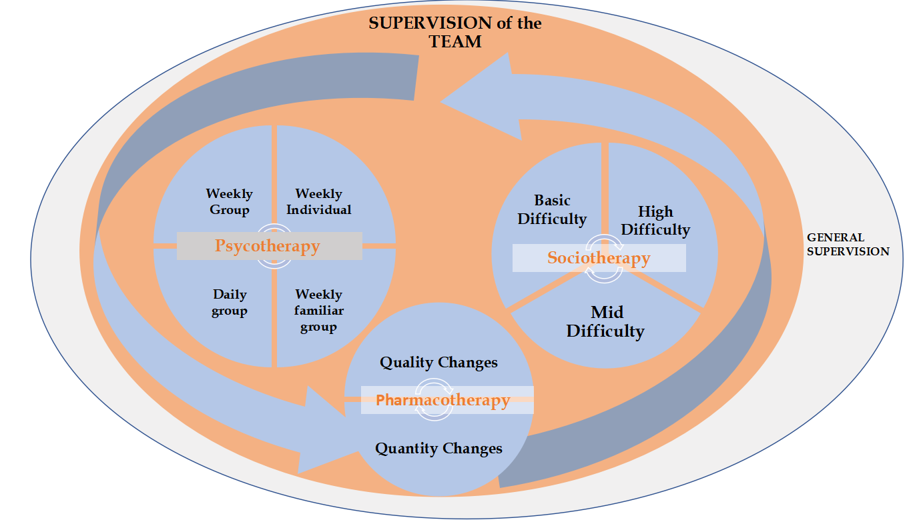
Integration
of settings
Body and Integration Research the primary symptom into the care of the psychosis

Slide 81
TREATMENT PHASES OF THE INTEGRATED STRUCTURAL MODEL
PHASE 1
ENGAGEMENT AND DISEASE AWARENESS OF THE PATIENT
(INDIVIDUAL -FAMILY)
PATIENT DISEASE AWARENESS IN THE INDIVIDUAL
PATIENT DISEASE AWARENESS IN THE FAMILY
DISEASE AWARENESS OF THE FAMILY
DECISION OF HEALING
Body and Integration Research the primary symptom into the care of the psychosis

Slide 82
TREATMENT PHASES OF THE INTEGRATED STRUCTURAL MODEL
PHASE 2
AWARENESS POSTULATES UNDERPINNING RELATIONAL STYLES THAT ENSURE PATIENT AND FAMILY STABILITY
(e.g. designated patient or scapegoat)
DECISION
TO
MODIFY THEM
THE CAPACITY FOR ASSERTIVENESS,
THE CAPACITY OF PROXIMITY AND INTEGRATION BETWEEN THEM
Body and Integration Research the primary symptom into the care of the psychosis

Slide 83
TREATMENT PHASES OF THE INTEGRATED STRUCTURAL MODEL
PHASE 3
DECISIONS
THE SAME
FURTHER TREATMENT
DIFFERENT
TREATMENT INTERRUPTION
PATIENT AND FAMILY TAKE DIFFERENT PATHS
DIFFERENTIATION OF PATIENT DECISIONS (=INDIVIDUAL-FAMILY)
Body and Integration Research the primary symptom into the care of the psychosis

Slide 84
PATIENT (INDIVIDUAL-FAMILY)
PUBLIC HEALTH SERVICE
COMMUNITY (its constituent entities)
RESOURCES
=
RULE OF MAJORITY
Body and Integration Research the primary symptom into the care of the psychosis

Slide 85
PALMIRA PHASE 1- 14.8.19
Video non autorizzato alla pubblicazione
Engaging and Beginning
Disease Awareness
POSITIVE CONNOTATION, BEYOND «FEELING COMFORTABLE
HOPE FOR IMPROVEMENT
Body and Integration Research the primary symptom into the care of the psychosis

Slide 86
PHASE 1: Work on Palmira’s body - 21.7.2020
Body exercise: NORTH SOUTH CONNECTION (denotation and connotation)
Connection among the languages CO\E\FA
Staff training
Video non autorizzati alla pubblicazione
Body and Integration Research the primary symptom into the care of the psychosis

Slide 87
PALMIRA PHASE 1- 5.1.22
Engaging and Beginning
Disease Awareness
RULES FOR RELATING TO COMMUNITY
Video non autorizzati alla pubblicazione
Awareness of lack of staff convergence
BUILDING THE RESOURCES
Video non autorizzati alla pubblicazione
Body and Integration Research the primary symptom into the care of the psychosis

Slide 88
PALMIRA PHASE 1 – Awareness of illness in the family = THE BIRTH OF PATHOLOGY from being satisfied to bein not a problem - 19.1.23
Video non autorizzati alla pubblicazione
Where come the LACK OF RULES
TO SATISFY TO HAVE NO PROBLEMS (EVEN WHEN IT IS NOT RIGHT)
FAILURE TO ASSUME RESPONSIBILITY (ALWAYS SOMEONE ELSE’S FAULT)
WORK ON THE DECISION
Body and Integration Research the primary symptom into the care of the psychosis

Slide 89
PALMIRA PHASE 1 – Dialogue with Riccardo: Confusion before the beginning of anguish – 1.3.23
Disease Awareness
Video non autorizzati alla pubblicazione
SPACE-TIME CONFUSION
INTEGRATION OF EMOTIONAL LANGUAGE: THE BIRTH OF SADNESS
NEED FOR A REFERENCE POINT
Body and Integration Research the primary symptom into the care of the psychosis

Slide 90
ROBERTO PHASE 1 – 12.2.2020
Engaging and Beginning
Disease Awareness
Video non autorizzati alla pubblicazione
BUILD THE RIGHT DISTANCE FROM THE SISTER
PURPOSE= TO BUILD THE PARENTAL CAPACITY OF ROBERTO «TO SAY NO TO HELP GROW WITHIN THE SUBSYSTEM SIBLINGS»
Body and Integration Research the primary symptom into the care of the psychosis

Slide 91
ROBERTO PHASE 1 – 28.7.2020
Engaging and Beginning
Disease Awareness
Video non autorizzati alla pubblicazione
BODY-EMOTIONAL WORK ON THE FEAR ( THE PROXIMITY OF A PARENT)
DESIRE TO GO HOME
EMOTIONAL AWARENESS THROUGH THE GROUP
Body and Integration Research the primary symptom into the care of the psychosis

Slide 92
ROBERTO PHASE 1- BODY WORK 30.3.22
Unconvinced Decision
Ex. Deflate bull, connect NORTH/ SOUTH
Video non autorizzati alla pubblicazione
Video non autorizzati alla pubblicazione
Connection among the languages
Video non autorizzati alla pubblicazione
Body and Integration Research the primary symptom into the care of the psychosis

Slide 93
ROBERTO PHASE 2 – 9.2.23
Disease Awareness and Decision
Video non autorizzati alla pubblicazione
AWARENESS AND IMPORTANCE OF DECISION FOR PROGNOSIS

Slide 94
ROBERTO PHASE 2 – 20.12.23
Disease Awareness and Decision
AWARENESS WORK ON BEING AN EGOCENTRIC CHILD
IMPORTANCE OF EXISTENTIAL POSITIONS G-A-B
IMPORTANCE OF INTERSUBJECTIVITY FOR PROGNOSIS
Video non autorizzati alla pubblicazione

Slide 95
Co-therapist of the family
From a scapegoat
To
THE
SECOND
PHASE
TODAY:
Body and Integration Research the primary symptom into the care of the psychosis

Slide 96
LAST FAMILY SUPERVISION - 28.5.2024
Awareness and Decision
Dialogue between parents on family disease awareness
Trans-generational relational structures
Video non autorizzati alla pubblicazione

Slide 97
THE PROGNOSIS ACCORDING TO THE PSYCHIATRIC MODEL
ONSET
SUMMARYZING
Disease worsens and the diagnosis changes
Pharmacological therapy
The vicious circle of chronocity
Symptoms increase
Symptoms decrease
Stimulus increase
Pharmacotherapy
reduces
Body and Integration Research the primary symptom into the care of the psychosis

Slide 98
PHARMACOLOGICAL PRESCRIPTIONS FOR PALMIRA BEFORE KAIROS
6/7/17 | Asl Solofra | Lorazepam 2,5 1 PILL EVENING
9/8/17 | Villa Dei Pini | Aripripazolo 5 1 PILLX4 - Perfenazina+amitriptilina Cloroidrato 1 PILL X4 - Carbamazepina 200 ½ PILL X2
24/10/17 | Asl Avellino | Carbamazepina 200 ½ PILL X3 - Perfenazina+amitriptilina Cloroidrato 1PILL Aripripazolo 10MG 1CP – Delorazepam 2mg 1CP + ½ CP WHEN NEEDED
14/11/17 | Asl Avellino | + Aripripazolo 10MG 1PILLX2
21/11/17 | Asl Avellino | Aloperidolo 0,25 15 DROPX3 - Delorazepam 1MG ½ DROP X2 + 1 PILL ON EVENING Aripripazolo 10MG 1PILLX2 - Perfenazina+amitriptilina Cloroidrato 1PILL Carbamazepina 200MG ½ PILLX3
30/11/17 | Asl Nola | Aloperidolo 5DROP X2 + 10DROP ON EVENING - Diazepam ½ PILL X2 Paroxetina ½ PILL
30/11/17 | Asl Nola | Aloperidolo 2% 7DROP X2 + 15DROP ON EVENING - Paroxetina ½ PILL Lorazepam 1PILL X2
16/12/17 | Asl Nola | Aloperidolo 2% 20DROPS X3
2/1/18 | Asl Avellino | Aloperidolo 5gtt X2 + 10DROPS ON EVENING - Paroxetina 20MG ½ PILL Diazepam 15 DROP X2 + 15DROP WHEN NEEDED
27/11/18 | Asl Avellino | Aloperidolo 10DROPS X2 - Acido Valproico CHRONO 500 2PILL MORNING + 1PILL ON EVENING Clonazepam 1 PILL
27/12/18 | Asl Avellino | Clorpromazina Cloridrato 1PILLX2 - Lorazepam ½ PILL MORNING + 1PILL ON EVENING
Body and Integration Research the primary symptom into the care of the psychosis

Slide 99
THE PROGNOSIS ACCORDING TO INTEGRATED STRUCTURAL MODEL
ONSET
HE
A
L
I
N
G
ATTEMPT TO BREAK THIS CIRCLE
Disease worsens and the diagnosis changes
Pharmacological therapy
The vicious circle of chronocity
Symptoms increase
Symptoms decrease
Stimulus increase
Pharmacotherapy
reduces
Body and Integration Research the primary symptom into the care of the psychosis

Slide 100
PHARMACOLOGICAL PRESCRIPTIONS FOR PALMIRA 2019\2024
30.7.19 First Therapy in Kairos | Aloperidolo 2MG15 dropsX2 Clonazepam 2MG 1\2 pillsX2 Valproic acid CHRONO 500 1\2 PILLS X2 | 15.1.21 | STOPS Clonazepam
20.9.19 | Aloperidolo 15 dropsX2 Clonazepam 10 dropsX2 Valproic acid CHRONO 500 1 PILL | 11.8.21 | Clotiapine 7dropsX3 Flurazepam 15 1 PILL
25.9.19 | REPLACE Haloperidol CN Clotiapine 10 dropsX3 | 17.11.21 | Clotiapine 8dropsX2 Clotiapine 5drops EVENING
17.1.20 | REDUCE Valproic acid to 1\2 PILLS | 17.8.22 | Clotiapine 8dropsX2 Clotiapine5drops EVENING Flurazepam 1 PILL Delorazepam 2MG 1 PILL IN CASE OF STRONG CRISIS Clotiapine 7drops IN CASE OF AGITATION
22.1.20 | STOP Valproic acid | 8.11.23 | Clotiapine 10dropsX3
24.1.20 | Clotiapie 10 dropsX3 Clonazepam 10dropsX2 | 18.1.24 | ADD Delorazepam 1MGX2
7.2.20 | ADD Flurazepam 15 EVENING | 30.1.24 | REPLACE Delorazepam 1MG CON Delorazepam 2MG
3.4.20 17.4.20 | Flurazepam 30MG Flurazepam | 3.2.24 | REPLACE Delorazepam 2MG CON Delorazepam 1MG
15.5.20 | STOP Flurazepam | 11.2.24 | GO To Delorazepam 0,5 X 2
23.9.20 | REDUCE Clotiapina 7dropsX 3 | 24.2.24 | STOP Delorazepam
Body and Integration Research the primary symptom into the care of the psychosis

Slide 101
PHARMACOLOGICAL PRESCRIPTIONS FOR ROBERTO 2020/2024
6.2.20 First Therapy in Kairos | Paliperidone 100MG 1 bottle each 30 days
7.2.20 | ADD Flurazepam 15MG EVENING | 6.7.22 | REDUCE Clotiapine DELLE 7.00 A 8 drops
1.3.20 | STOP Paliperidone, ADDING Clorpromazina Cloridrato 25MG X3 | 7.4.23 | STOP Clorpromazina REDUCE Clotiapine 8 drops X3
19.6.20 | REPLACE Clorpromazina Cloridrato 100MG EVENING | 1.5.23 | Clotiapine A 7 drops X3
7.8.20 | Clorpromazina Cloridrato 100MGX3 | 18.5.22 | STOP Clorpromazina Cloridrato at 9.00 hrs -Clotiapina X3 -Clorpromazina X2
12.5.21 | REPLACE in the morning Lorazepam 2.5 | 29.5.22 | STOP Clorpromazina
14.5.21 | Lorazepam ALSO AT 14,00 HRS | 6.7.22 | REDUCE Clotiapine from 7,00 hrs to 8drops
19.5.21 | Lorazepam ALSO IN THE EVENING | 7.4.23 | STOP Clorpromazina Clotiapine 8drops X3
18.8.21 | REPLACE Lorazepam WITH Delorazepam 2MG X3 | 1.5.23 | Clotiapine 7 drops 3
20.8.21 | STOPS Delorazepam WITH Clorpromazina Cloridrato 25 (8.00\14.00) | 26.7.23 | Clotiapine 9 drops X3
27.8.21 | Clorpromazina Cloridrato 25 X3 | 9.9.23 | Clotiapine 5 dropsX3
29.8.21 | ADD Clotiapine 5 drops X3 | 21.1.24 | Clotiapine 4 dropsx2
30.8.21 | GO TO Clotiapina 10dropsX3 | 4.2.24 | REDUCE Clotiapine 3 dropsX2
18.5.22 | Clotiapine 10 dropsX3 Clorpromazina 100 X2 | 18.2.24 | Clotiapine 2 dropsX2
29.5.22 | STOP Clorpromazina at 14,00 hrs | 3.3.24 | STOPS Clotiapine
Body and Integration Research the primary symptom into the care of the psychosis

Slide 102
RESULTS
REDUCTION OF SYMPTOMS
ABSENCE OF FORCED AND VOLUNTARY HOSPITALISZATION
REDUCTION OF MEDICINES
Body and Integration Research the primary symptom into the care of the psychosis

Slide 103
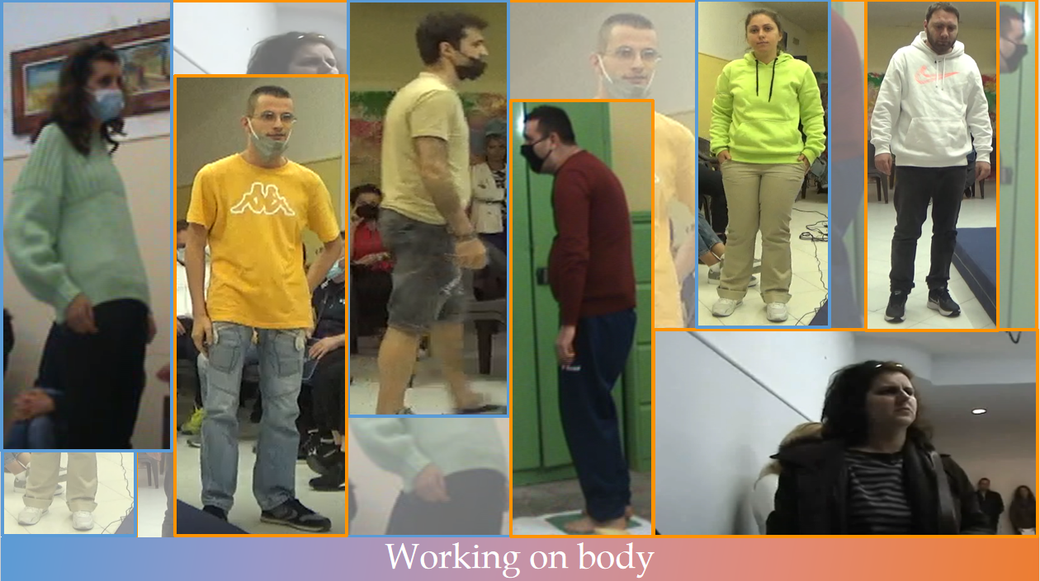
3. Body work in treatment of mental illness/psychosis
3.1 Body Language
Learn to read
Primary elements of body language
Syllables-Words-Sentences
3.2 Be in relationship= Learn to speak
Primary relashionships
3.3 Working on the body into the care of mental illness
Why
How intervent
When
3.4 Mental illness from the body language view
Body diagnosis according to Integrated Structural Model

Slide 104
Body Language

Slide 105
Reality
Perception
SUBJECT
OBJECT
Body and Integration Research the primary symptom into the care of the psychosis

Slide 106
The 6 senses
SHIGHT
PROPRIOCEPTION
SMELL
The
Perception
TASTE
TOUCH
HEARING
Body and Integration Research the primary symptom into the care of the psychosis

Slide 107
THE FIRST PERCEPTION
THE PROPRIOCEPTION: the sixth sense
WHERE I AM
I AM
RULE
PROPRIOCEPTION
RULE OF THE CLOSENESS
Body and Integration Research the primary symptom into the care of the psychosis

Slide 108
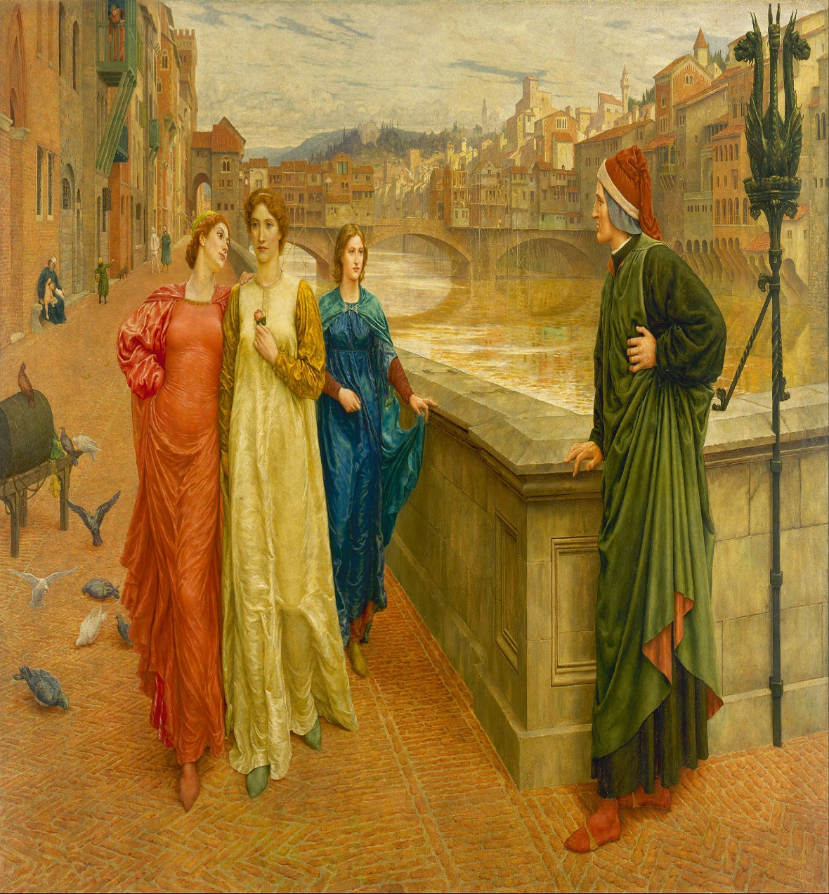
THE SIGHT
I AM
YOU ARE
WHERE I GO
RULE
THE SIGHT
RULE OF THE DISTANCE
Body and Integration Research the primary symptom into the care of the psychosis

Slide 109
BODY READINGS
INTEGRATED HIERARCHICAL BODY READINGS
SIGHT
PROPRIOCEPTION
INTEGRATION
INTEGRATION
SIGHT
PROPRIOCEPTION
Body and Integration Research the primary symptom into the care of the psychosis

Slide 110
PRIMARY ELEMENTS
NEEDS
PROPRIOCEPTION
BREATH
CONNECTION BETWEEN PARTS
MUSCULAR TONE
MUSCULAR TROPHISM
Body and Integration Research the primary symptom into the care of the psychosis

Slide 111
TONE
STATIC GLOBAL READING
TROPHISM
CONNECTING
LINES
FROM HEAD
TO FOOT
FRONT, BACK,
SIDE
Images of the whole body in front, back, left and right side positions
GLOBAL SHAPES
(ADULT, CHILD)
RELASHIONSHIP
BETWEEN
MAJOR
SECTORS:
DIMENSIONS
Body and Integration Research the primary symptom into the care of the psychosis

Slide 112
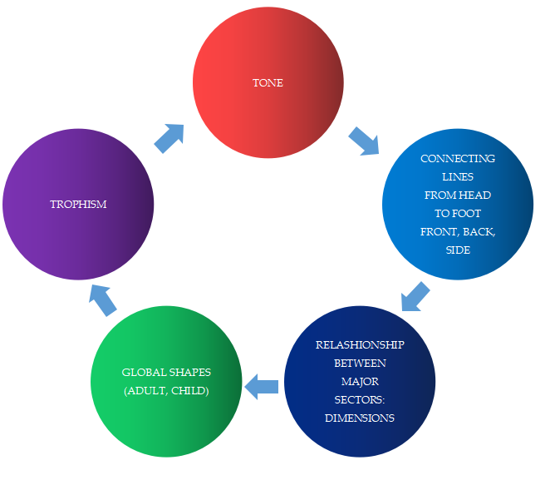
DYNAMIC GLOBAL READING
Movies of body in motion: walking
CONFIRMATION OR UNDERMINING OF THE PREVIOUS READING
Body and Integration Research the primary symptom into the care of the psychosis

Slide 113
Static
Global
Reading
COHERENCE/
INCOHERENCE
Dynamic
Global
Reading
Body and Integration Research the primary symptom into the care of the psychosis

Slide 114
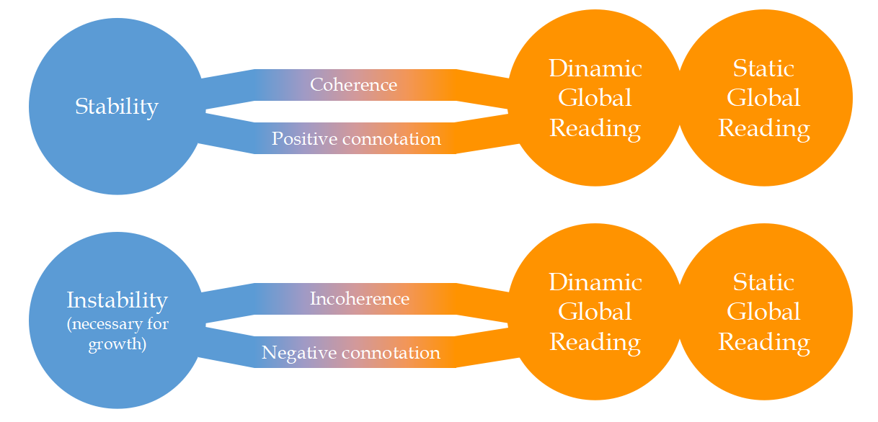
1
2
New
3
Body and Integration Research the primary symptom into the care of the psychosis

Slide 115
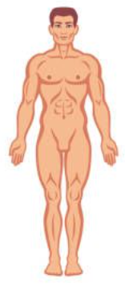
Words
1. HEAD
NECK
1.1 EYES
1.2 MOUTH
SHOULDERS
2. CHEST
DIAPHRAGM
3. ABDOMEN
4. PELVIS
Syllables
5. UPPER ARTS
ELBOW
4.1 ARM
4.2 FOREARM
4.3 HANDS
Sentences
WRIST
HIP
6. LOWER ARTS
KNEE
5.1 THIGH
5.2 LEG
5.3 FEET
ANKLE
Body and Integration Research the primary symptom into the care of the psychosis

Slide 116
Body elements comunicate meaning
to be catched
What are they telling us?
Body and Integration Research the primary symptom into the care of the psychosis

Slide 117
BODY LANGUAGE IMPORTANCE
The body is our history,
is the record of our knwonledge that has become automatic/spontaneous
beyond awerness,
but is embodied in our bones, on our skin, in our muscles, in our breath.
(Ariano)
Body and Integration Research the primary symptom into the care of the psychosis

Slide 118
BE IN RELATIONSHIP = LEARN TO SPEAK
Be in relationship

Slide 119
Comunication is possible in a relationship
with oneself or with each other
verbally or non-verbally
Body and Integration Research the primary symptom into the care of the psychosis

Slide 120
PRIMARY RELATIONSHIPS
FEEL GOOD ABOUT ONESELF
FEEL GOOD ABOUT ONESELF AND EACH OTHER IN SEPARATION
FEEL GOOD ABOUT ONESELF AND EACH OTHER IN CLOSENESS
STABILITY
ASSERTIVNESS
PROXIMITY
Body and Integration Research the primary symptom into the care of the psychosis

Slide 121
THE BIG SECTORS
Stability
Neck
Assertiveness
Diaphragm
Proximity
Connections
Hip
Knee
Ankle
Stability
Body and Integration Research the primary symptom into the care of the psychosis

Slide 122
Why working on body?
How intervent?
When?
Body and Integration Research the primary symptom into the care of the psychosis

Slide 123
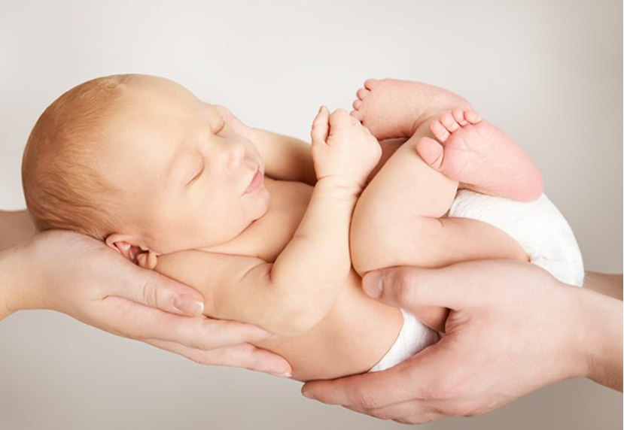
Why working on body?
Is the first language that records, memorizes and acts spontaneously.
Foundation of Identity - Who I am? -
and Relationship - How do I stay with myself, the others and the world?
Body and Integration Research the primary symptom into the care of the psychosis

Slide 124
The ground for other languages
A specific type of body allows specific thoughts and no others, specific emotions and no others, specific fantasies and no others.
(G. Ariano)
Body and Integration Research the primary symptom into the care of the psychosis

Slide 125
From body to other languages
Video non autorizzato alla pubblicazione
Body and Integration Research the primary symptom into the care of the psychosis

Slide 126
Connection among languages
COHERENT ELEMENTS BIRTH WITH THE BODY PATTERN
E
Emotional
Fa
Fantasy
Ra
Rational
Opens the space for anger in emotive language and cognitive language
A integrated organization born
Bo
Body
BITE AND GRIT THEETH:
ANGER’S BODY PATTERN
Body and Integration Research the primary symptom into the care of the psychosis

Slide 127
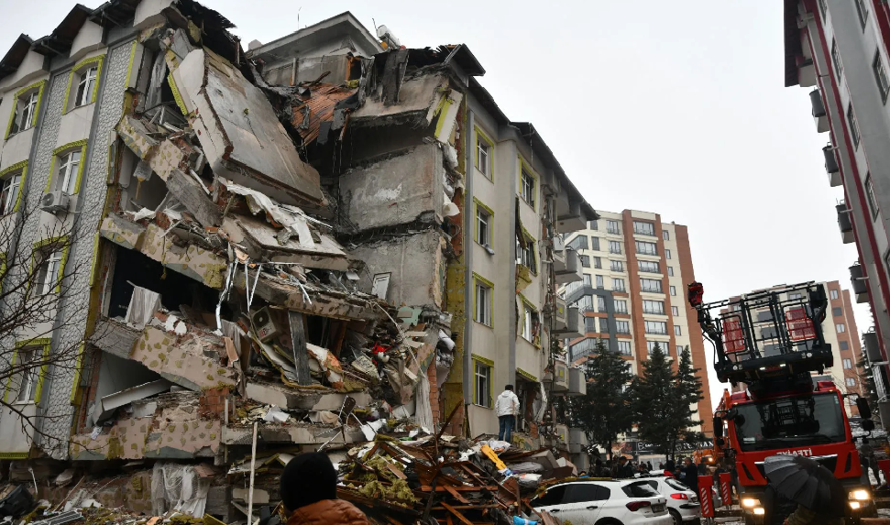
How intervent?
Incoherent unfunctional denotations/connotations
in the body language
to be changed in
new coherent and funcional denotations/connotations
that allow connections with the others languages
QUALITATIVE
JUMP
Body and Integration Research the primary symptom into the care of the psychosis

Slide 128
Needs
Connections
Tone
Trophism
Denote
Connote
Link to the other languages
Proprioception/Breath
Muscles
Junctions
Global
Sectors
Subsectors
Build
Elasticise
Body and Integration Research the primary symptom into the care of the psychosis

Slide 129
Body therapy steps
E
Emotional
Fa
Fantasy
Ra
Rational
Positive/Pleasant
4. Connections
Negative/Unpleasant
Connection block with others languages
3. Connote
2. Denote
Give a name
to sensations
Feel and stay with own sensations
1. Proprioception Ability
Body and Integration Research the primary symptom into the care of the psychosis

Slide 130
denote: “tingling”
connote: “much better”
connection with other language: fantasy and rational
Video non autorizzato alla pubblicazione
Body and Integration Research the primary symptom into the care of the psychosis

Slide 131
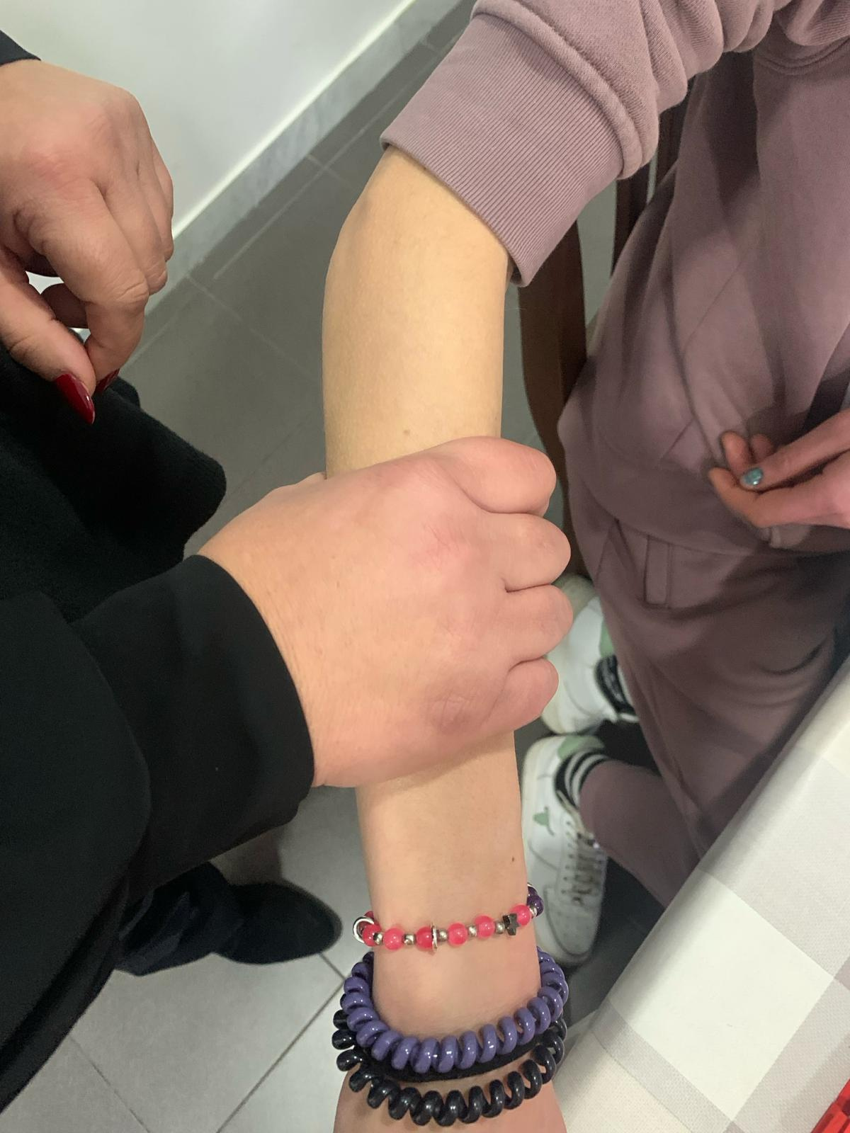
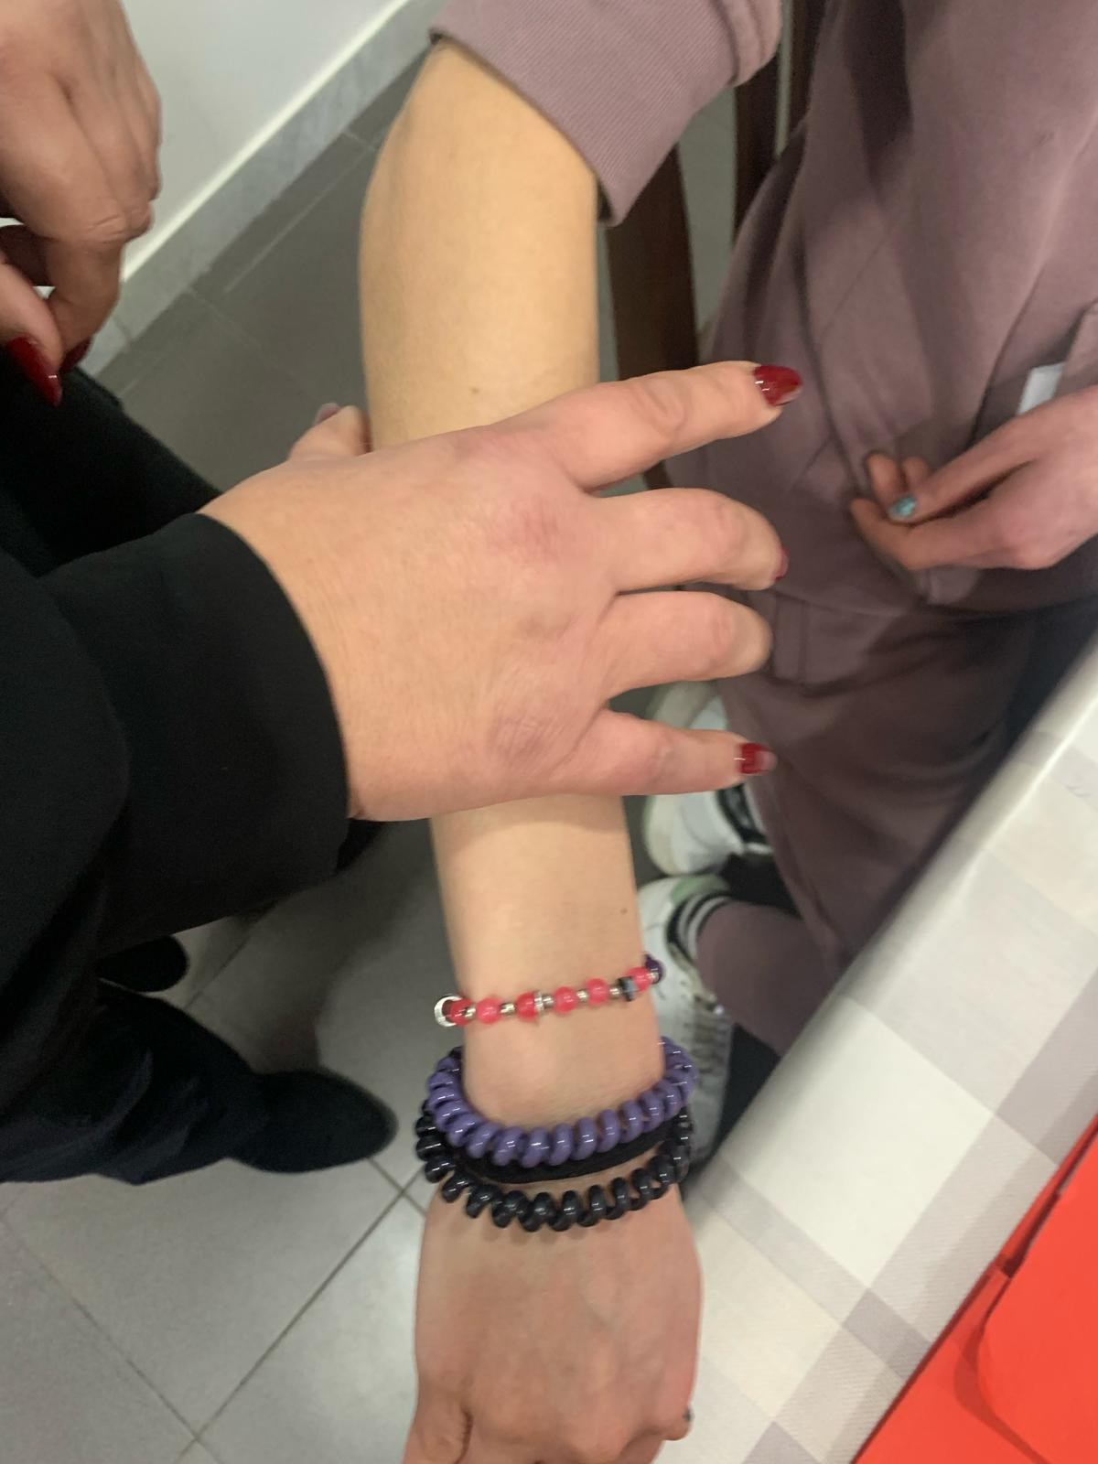
Muscle feeding
1. Press muscle until it pulsed
2. Leave
3. Repeat
Body and Integration Research the primary symptom into the care of the psychosis

Slide 132
Needs
Connections
Tone
Trophism
Denote
Connote
Link to the other languages
Proprioceptin/Breath
Muscles
Junctions
Global
Sectors
Subsectors
Build
Elasticise
Body and Integration Research the primary symptom into the care of the psychosis

Slide 133
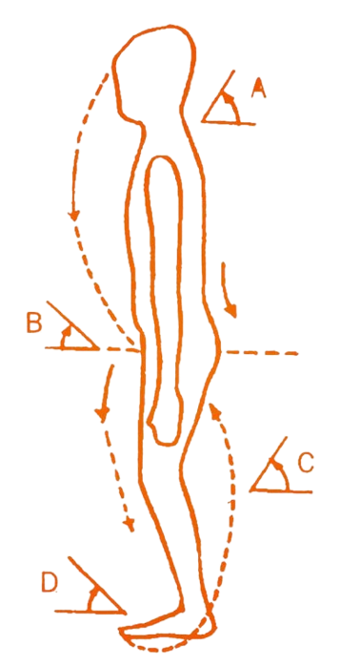
Hypertonic junction
Rigidity
makes difficult to take a grounding position
Body and Integration Research the primary symptom into the care of the psychosis

Slide 134
Needs
Connections
Tone
Trophism
Denote
Connote
Link to the other languages
Proprioception/Breath
Muscles
Junctions
Global
Sectors
Subsectors
Build
Elasticise
Body and Integration Research the primary symptom into the care of the psychosis

Slide 135
AUTOMATIC/SPONTANEOUS POSTURE
CONCIOUS POSTURE CHANGE
Video non autorizzato alla pubblicazione
Video non autorizzato alla pubblicazione
03/21
09/22
- Patient’s stability
- Body reading by therapist
Therapist intervention to create instability
Body and Integration Research the primary symptom into the care of the psychosis

Slide 136
Needs
Connections
Tone
Trophism
Denote
Connote
Link to the other languages
Propriocetion/Breath
Muscles
Junctions
Global
Sectors
Subsectors
Build
Elasticise
Body and Integration Research the primary symptom into the care of the psychosis

Slide 137
PRIMARY RELATIONSHIPS
Stability
Assertivness
Proximity
Body and Integration Research the primary symptom into the care of the psychosis

Slide 138
Anger pattern
Build a new pattern: fist pump
From negative to positive connotation
Bo-E-Ra connection
Video non autorizzato alla pubblicazione
Body and Integration Research the primary symptom into the care of the psychosis

Slide 139
Needs
Connections
Tone
Trophism
Denote
Connote
Link to the other languages
Proprioception/Breath
Muscles
Junctions
Global
Sectors
Subsectors
Build
Elasticise
Body and Integration Research the primary symptom into the care of the psychosis

Slide 140
PRIMARY RELATIONSHIPS
Stability
Assertivness
Proximity
Body and Integration Research the primary symptom into the care of the psychosis

Slide 141
Create unit
Video non autorizzato alla pubblicazione
Upper-lower body connection
Increse breath and proprioception
Negative connotation of a proprioception
Body and Integration Research the primary symptom into the care of the psychosis

Slide 142
Needs
Connections
Tone
Trophism
Denote
Connote
Link to the other languages
Proprioception/Breath
Muscles
Junctions
Global
Sectors
Subsectors
Build
Elasticise
Body and Integration Research the primary symptom into the care of the psychosis

Slide 143
Building thinking ability from the body
Phase 1 11/22
Automatic connection between parts is absense of thought
Changing connection between parts as like who think, thinking’s fear pattern comes up=breath absense
Video non autorizzato alla pubblicazione
Body and Integration Research the primary symptom into the care of the psychosis

Slide 144
Needs
Connections
Tone
Trophism
Denote
Connote
Link to the other languages
Proprioception/Breath
Muscles
Junctions
Global
Sectors
Subsectors
Build
Elasticise
Body and Integration Research the primary symptom into the care of the psychosis

Slide 145
PRIMARY RELATIONSHIPS
Stability
Assertivness
Proximity
Body and Integration Research the primary symptom into the care of the psychosis

Slide 146
Positive connotation
Phase 2 07/23
Video non autorizzato alla pubblicazione
Consolidation new connection with a positive connotation: breath’s presence
Body and Integration Research the primary symptom into the care of the psychosis

Slide 147
Needs
Connections
Tone
Trophism
Denote
Connote
Link to the other languages
Proprioception/Breath
Muscles
Junctions
Global
Sectors
Subsectors
Build
Elasticise
Body and Integration Research the primary symptom into the care of the psychosis

Slide 148
The presence of the ability to think
Phase 3 09/23
Video non autorizzato alla pubblicazione
Body conditions are created to recognize fear and build thinking
Birth of the proximity need, making friends
Body and Integration Research the primary symptom into the care of the psychosis

Slide 149
Needs
Connections
Tone
Trophism
Denote
Connote
Link to the other languages
Proprioception/Breath
Muscles
Junctions
Global
Sectors
Subsectors
Build
Elasticise
Body and Integration Research the primary symptom into the care of the psychosis

Slide 150
When start body therapy?
Therapy process
Phase 1
Phase 2
Phase 3
Patient's illness conciousness
Care decision
Start body therapy
Body and Integration Research the primary symptom into the care of the psychosis

Slide 151
Conditions
Video non autorizzato alla pubblicazione
Steps:
Illness conciousness
Prediction of consequences = responsability
Free choise
Decision
Body and Integration Research the primary symptom into the care of the psychosis

Slide 152
Mental illness

Slide 153
USEFUL QUESTIONS FOR MAKING BODY DIAGNOSIS
Body language is present or absent?
Body speaks to who?
DUMB: absent body, speaks neither itself nor to others
FEARED: present body, kept away from self. Speaks to others and cannot speak with itself
DISSOCIATED (FED or DEPRIVED): present body, kept away from self, speaks to others and can speak with itself
How are the big sector organized?
Integration
Dissociation
How are the subsector organized?
Integration
Fragmentation: floppy or rigid
What is the integration level with the others languages?
Body and Integration Research the primary symptom into the care of the psychosis

Slide 154
Diagnosis:
Paranoid-type schizophrenia
ISM Diagnosis:
Paranoid rigid Structure
Diagnosis:
Chronic disorganized schizophrenia
ISM Diagnosis:
Confluent Structure
Diagnosis:
Chronic disorganized schizophrenia
ISM Diagnosis:
Dissociated Structure
Diagnosis:
Psychosis
ISM Diagnosis:
Dissociated Structure
Foto della paziente non autorizzati alla pubblicazione
Foto della paziente non autorizzati alla pubblicazione
Foto della paziente non autorizzati alla pubblicazione
Foto della paziente non autorizzati alla pubblicazione
DUMB BODY
FEARED BODY
DEPRIVED DISSOCIATED BODY
FED DISSOCIATED BODY
Severity
Body and Integration Research the primary symptom into the care of the psychosis

Slide 155
T.: Paranoid rigid Primary Symtomp: Dumb body
The body that speaks neither to itself nor to others
NEEDS:
Absent
BREATH:
Absent
MUSCULAR TONE: Hypertone
MUSCULAR TROPHISM:
Sightly hypotrophic
Foto della paziente non autorizzati alla pubblicazione
PROPRIOCEPTION: Absent
“Nothing happens in my body! Every stimulus is unknown and incomprehensible to me.”
CONNECTION BETWEEN THE PARTS:
Rigid fragmentation
Body and Integration Research the primary symptom into the care of the psychosis

Slide 156
Body language must first be brought into the world of life
Ra
Rational
Fa
Fantasy
Rigid deductive thinking (inelastic)
Foto della paziente non autorizzati alla pubblicazione
E
Emotional
Anger
Primary symptom: Dumb body
Bo
Body
Unfavorable condition for the new concept construction
Body and Integration Research the primary symptom into the care of the psychosis

Slide 157
From 2020 to 2024
BODY THERAPY
PHARMACOTHERAPY
Work goals:
Elasticize in a way that allows connections with other languages
Building body sensations
Exercise:
1) Shower with hot/cold water
2) Arch on stool
3) Massage with intermittent pressure
4) Squat
5) Mattress
Pharmacotherapy at admission:
At admission not known
Pharmatherapy to resignation 05/2024:
None
Foto della paziente non autorizzati alla pubblicazione
Body and Integration Research the primary symptom into the care of the psychosis

Slide 158
L. : Confluent Structure Primary symptom: Body feared
The body speaks only to the other and cannot speak to itself
NEEDS:
Absent
BREATH:
Locked
MUSCULAR TONE: Hypertone
MUSCULAR TROPHISM:
Trophic
Foto della paziente non autorizzati alla pubblicazione
“What I feel in my body is too dangerous!”
PROPRIOCEPTION: Absent
CONNECTION BETWEEN THE PARTS:
Rigid fragmentation
Body and Integration Research the primary symptom into the care of the psychosis

Slide 159
Body language must first be contained. It is necessary to build a sense of limitation
Ra
Rational
Fa
Fantasy
Absent
Foto della paziente non autorizzati alla pubblicazione
E
Emotional
Fear becoming anger
Primary symptom: Feared body
Bo
Body
Unfavorable condition for the integration construction
Body and Integration Research the primary symptom into the care of the psychosis

Slide 160
From 2018 to 2023
BODY THERAPY
PHARMACOTHERAPY
Work goals:
Birth of propriocetion:
From automatic discharge to intentional discharge;
Prevent discharge;
Breaking rigid connections;
Being with the proprioception that arises.
Exercises:
1) Stilts
2) Bell
3) Straitjacket
4) Squat
5) Roll over
6) Mattress + bent legs
History of forced and voluntary hospitalizations
Pharmacotherapy at admission:
Clozapina 100 mg 3 cp per day
Amisulpiride 400 mg 1 cp per day
Pharmacotherapy to resignation (10/23):
Acido valproico 500 mg 1 x 3
Clotiapina 10gtt
Biperidene 4 mg
Aloperidolo 1 fiala da 150 mg (28gg)
Foto della paziente non autorizzati alla pubblicazione
Body and Integration Research the primary symptom into the care of the psychosis

Slide 161
M.: Dissociated Structure Primary symtom: Deprived dissociated body
The body speaks to others and can speak with itself
NEEDS:
Absent
BREATH:
Absent
MUSCULAR TONE:
Hypo-Hypertone
MUSCULAR TROPHISM:
Hypotrophic
Foto della paziente non autorizzati alla pubblicazione
“What I felt in the body I lost, because it was not nurtured, I have to relearn it”
PROPRIOCEPTION: Absent
CONNECTION BETWEEN THE PARTS:
Rigid fragmentation
Body and Integration Research the primary symptom into the care of the psychosis

Slide 162
A deprived body needs before being nourished
Ra
Rational
Fa
Fantasy
Poor and disorganized
Foto della paziente non autorizzati alla pubblicazione
E
Emotional
Absent
Primary symptom:
Deprived dissociatedbody
Bo
Body
Unfavorable condition for the new concepts construction
Body and Integration Research the primary symptom into the care of the psychosis

Slide 163
From 2018 to 2024
BODY THERAPY
PHARMACOTHERAPY
Work goals:
Feed the muscles;
Reduce rigidity:
Exercises:
1) Arm and leg massage
2) Hot/cold shower
3) Inflating balloons
4) Walking with bent knees
5) Squatting for 15 seconds
6) Stool
7) Squat
8) Heeled shoes
9) Grounding
10) Mattress
Pharmacotherapy at admission:
None with disorganized schizophrenia diagnosis
Pharmacotheray today:
None
Foto della paziente non autorizzati alla pubblicazione
Body and Integration Research the primary symptom into the care of the psychosis

Slide 164
S.: Dissociated Structure Primary symptom: Fed dissociated body
The body speaks to others and can speak with itself
NEEDS:
Present
BREATH:
Locked
MUSCULAR TONE:
Tonic
MUSCULAR TROPHISM:
Trophic
Foto della paziente non autorizzati alla pubblicazione
“I can't name what I feel so I keep it away”
PROPRIOCEPTION: Inchoerent
CONNECTION BETWEEN THE PARTS:
Floppy fragmentation
Body and Integration Research the primary symptom into the care of the psychosis

Slide 165
The absence of a cognitive structure that organizes the elements present determines their discharge
Ra
Rational
Fa
Fantasy
Absent
Foto della paziente non autorizzati alla pubblicazione
E
Emotional
Fear
Anger
Sadness
Primary symptom:
Fed dissociatedbody
Bo
Body
Favorable condition for integration
Body and Integration Research the primary symptom into the care of the psychosis

Slide 166
From 2020 to 2024
Foto della paziente, non autorizzati alla pubblicazione
BODY THERAPY
PHARMACOTHERAPY
Work goals:
to promote connection among parts
Exercise:
1) Inflating balloons
2) Walking with balloon at knees
3) Grounding
4) Squats for 15 seconds
5) Stilts
6) Roll over
Pharmacotherapy at admission:
Lorazepam 1,5 cp x 3;
Olanzapina 1 cp 2,5 mg;
Clorazepam gtt 4x2.
Pharmacotherapy today:
Clotiapina 6 gtt x 2 + 8 in the evening
Body and Integration Research the primary symptom into the care of the psychosis

Slide 167
CONCLUSIONS
The reading of body language and the level of integration with other languages allows to identify the primary symptom of mental illness
The core of restructuring rehabilitation is psychotherapy
The core of psychotherapy is relationship
The core of relationship is language
The core of language is integration\coherence
The core of mental illness is incoherence\dissociation
The core of care is the recovery of integration\coherence

Slide 168
Body and Integration Research the primary symptom into the care of psychosis
Thank you for
your attention
Notes:
il lavoro sul corpo nella cura della psicosi

