Slide 1
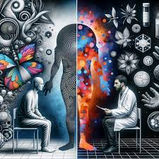
THE EXPERIENCE IN TREATMENT OF PSYCHOSIS
Dr. Maria Cesarano
Dr. Marina Rega
Dr. Carmina Russo

Slide 2
WARNING
This presentation contains videos showing real patients
We have permission to use the material only for scientific purposes
Audio or video recording is not allowed
As for the recording by the ISPS, its dissemination on the Internet or in non-scientific contexts is strictly prohibited

Slide 3
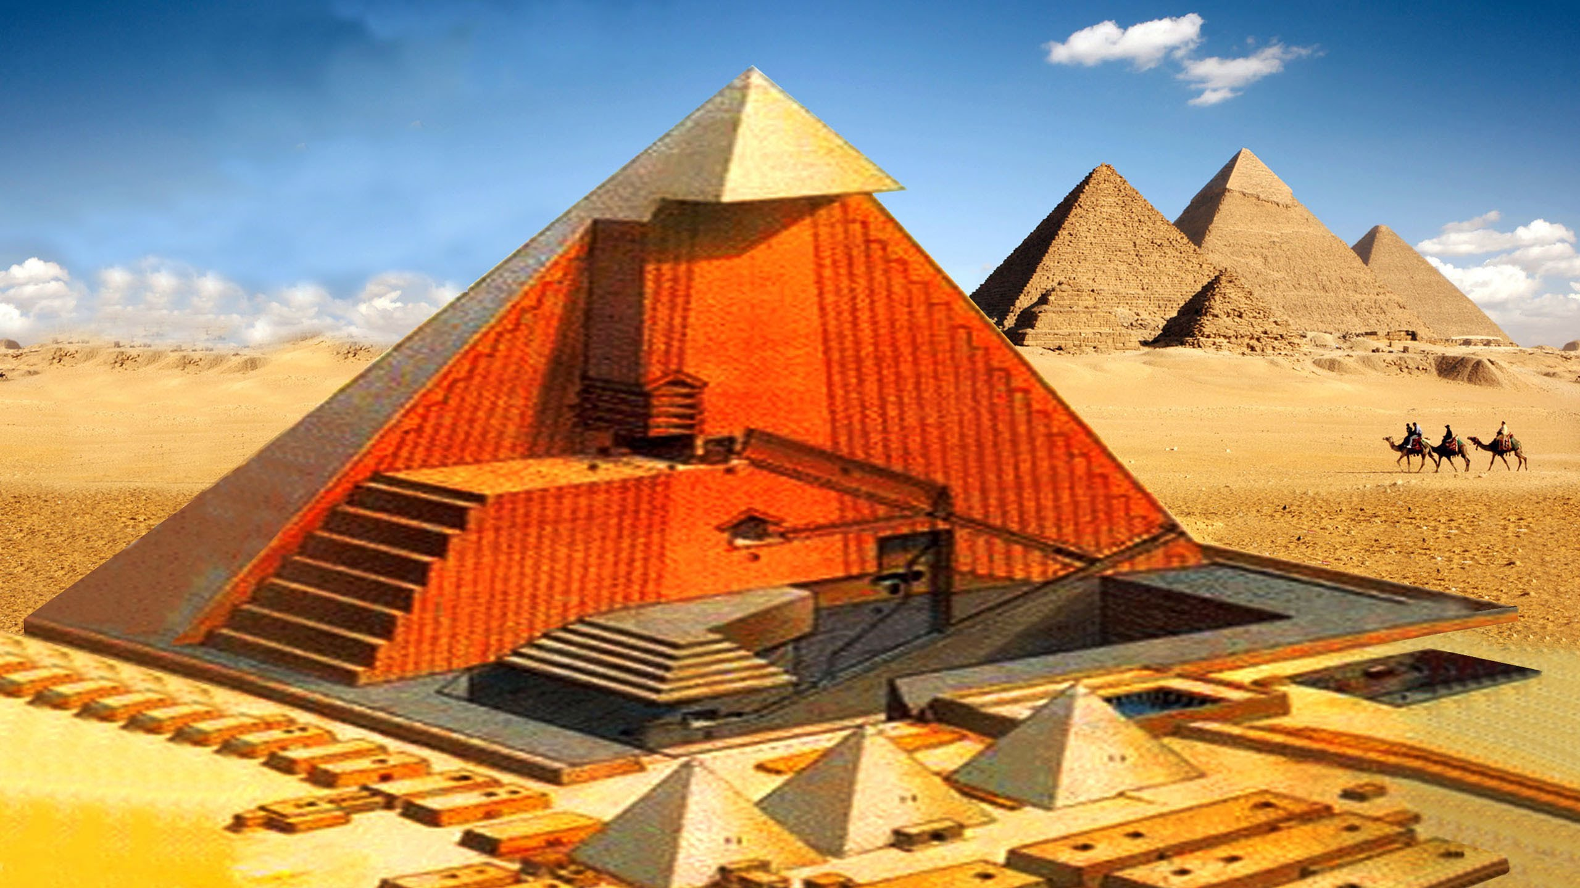
1.THEORETICAL PREMISES
1.1 PSYCHOSIS AND ITS TREATMENT
1.2 THE DOMINANT MODELS
1.3 THE TWO VERSIONS OF THE BIO-PSYCHO-SOCIAL MODEL
1.3.1 EPISTEMOLOGICAL DIFFERENCES
1.3.2 ANTHROPOLOGICAL DIFFERENCES
1.3.2.1 view of the healthy human being
1.3.3 PSYCHOPATHOLOGICAL DIFFERENCES
1.3.3.1 The eclectic model
1.3.3.2 The structural model
1.4 THE RESULTING REHABILITATION MODELS
»Safe Failing Model» «Restructuring Model»
2.THREE PSYCHOTIC PATIENTS
PSYCHOSIS TREATMENT EXPERIENCE WITHIN THE TWO MODELS
2.1 ANAMNESIS AND CLINICAL DECRIPTION
2.1.1 THE CAUSES OF THE VICIOUS CYCLE OF PSYCHOSIS
2.1.1.1 DIAGNOSTIC METHODS
2.1.1.2 TREATMENT
2.2 INTERRUPTING THE VICIOUS CYCLE: RESTRUCTURING MODEL
2.2.1 DIAGNOSIS AND
2.2.2 TREATMENT
Questa foto di Autore sconosciuto è concesso in licenza da CC BY-NC

Slide 4
1 THEORETICAL PREMISES
1.1 PSYCHOSIS AND ITS TREATMENT
“EACH WORD CHANGES ITS MEANING ACCORDING TO THE CONTEXT (MODEL, LANGUAGE)
IN WHICH IT OCCURS”
G. Ariano
THE UNDERSTANDABILITY OF THE PSYCHOTIC PATIENT

Slide 5
1.1.1 THE DOMINANT MODELS
BIOLOGICAL MODEL
BIO-PSYCHO-SOCIAL MODEL
PSYCHOSIS IS A BRAIN DYSFUNCTION
(BRAIN AS A BIOLOGICAL ORGANISM)
AFFECTING THE PSYCHOLOGICAL LEVEL
PSYCHOSIS ARISES FROM THE NEFARIOUS INFLUENCE OF THREE FACTORS:
BIOLOGICAL, PSYCHOLOGICAL AND SOCIAL.

Slide 6
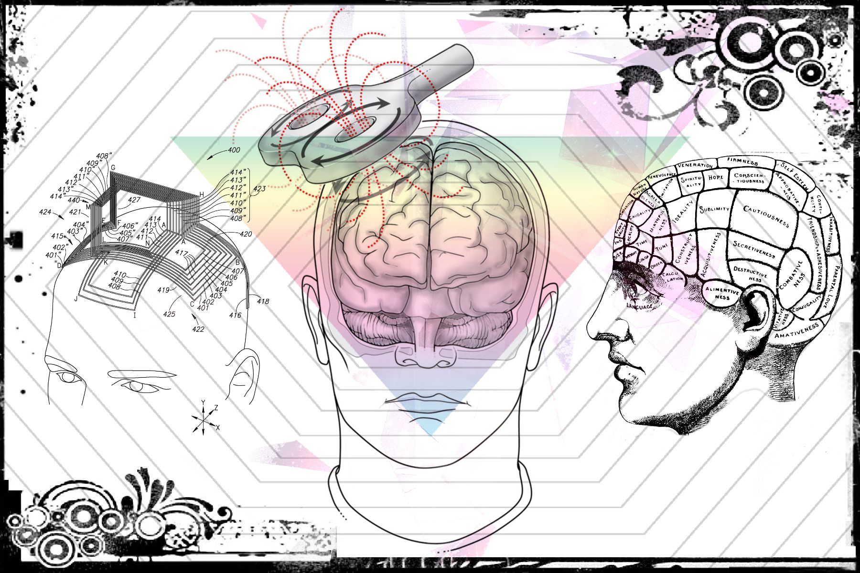
1.3
THE TWO VERSIONS
OF THE BIO-PSYCHO-SOCIAL MODEL

Slide 7
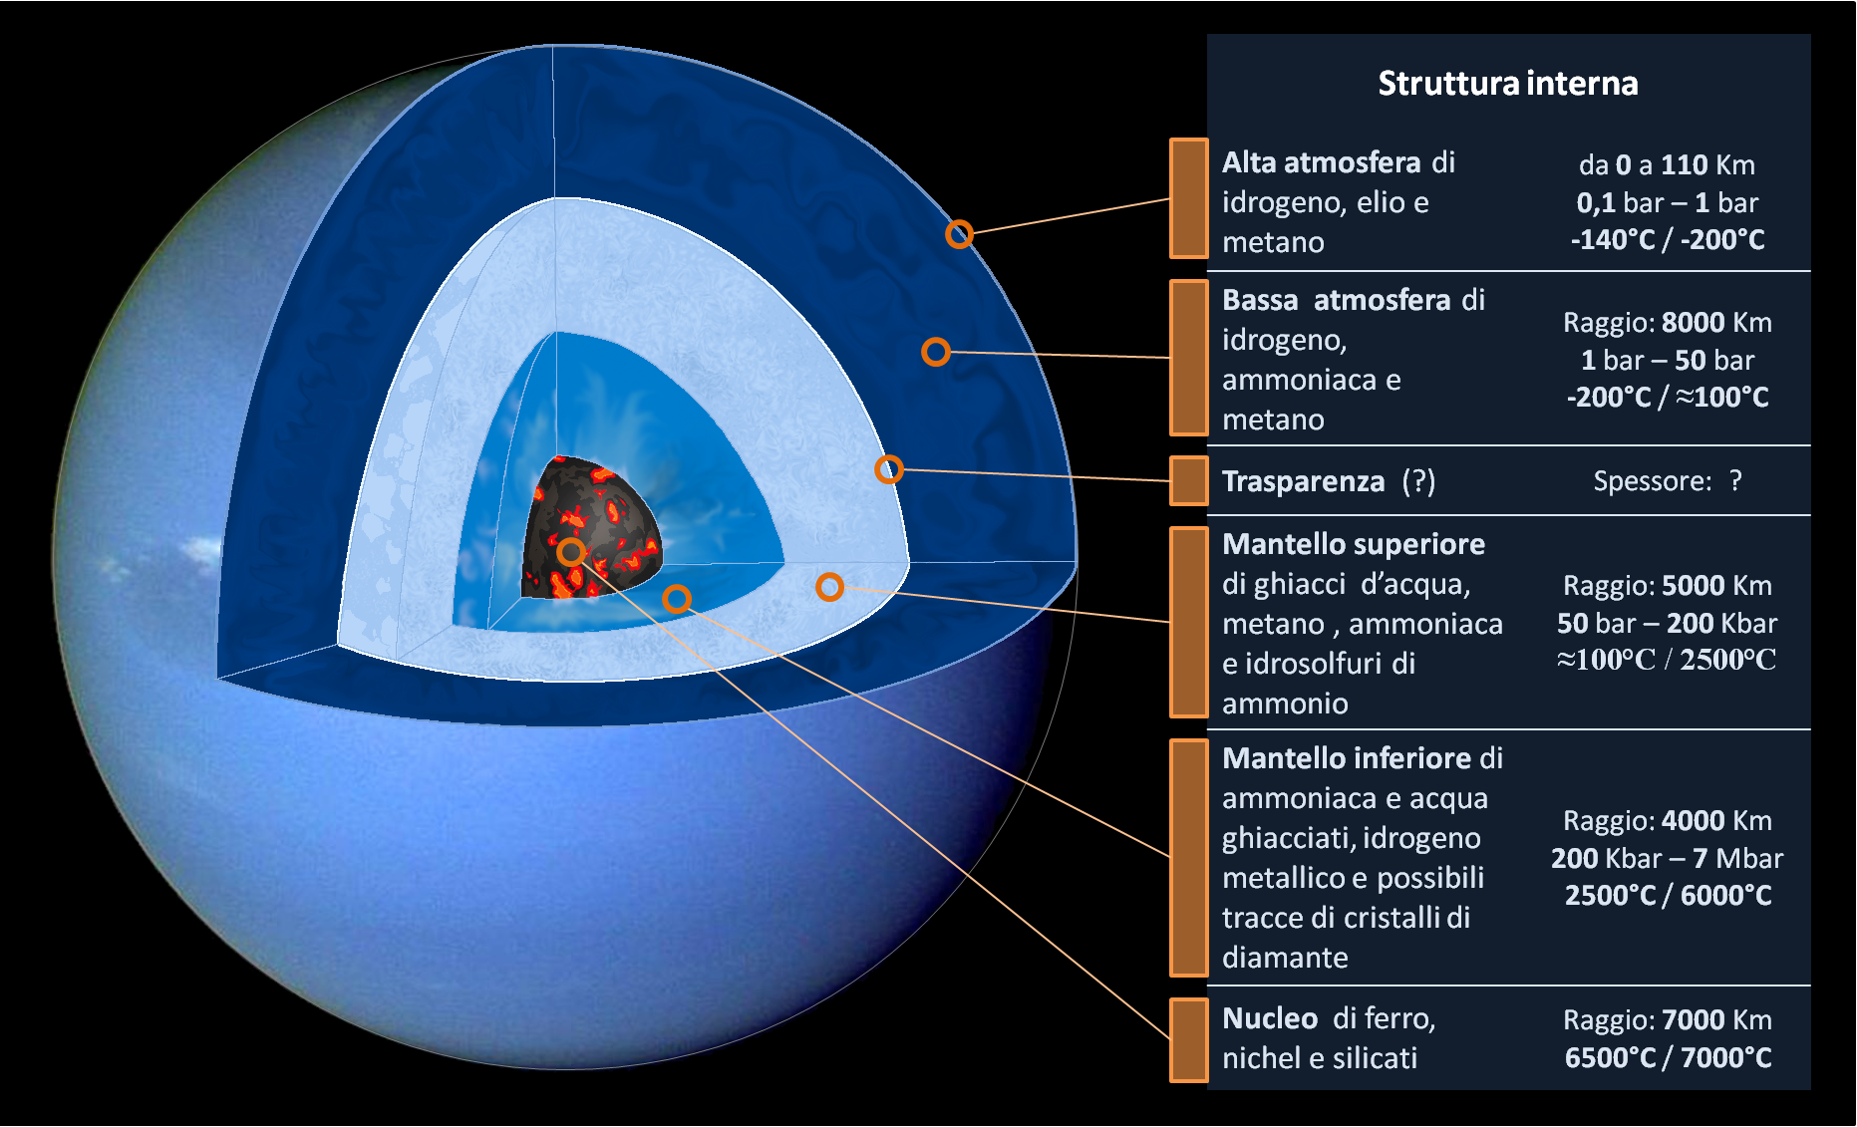
ECLECTIC MODEL
STRUCTURAL MODEL
Questa foto di Autore sconosciuto è concesso in licenza da CC BY
Questa foto di Autore sconosciuto è concesso in licenza da CC BY-SA

Slide 8
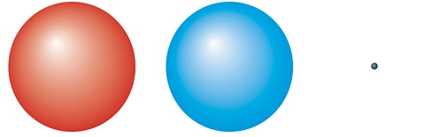
ECLECTIC MODEL
Reality exists and is made of Atoms
EPISTEMOLOGICAL CONSIDERATIONS

Slide 9
STRUCTURAL MODEL
EPISTEMOLOGICAL
CONSIDERATIONS
Reality exists and is made of Structures

Slide 10
1.3.1 Epistemological differences
ECLECTIC MODEL
STRUCTURAL MODEL
ATOMISM (=ALL ELEMENTS ARE IDENTICAL)
THE NOTION OF LOGICAL LEVELS IS REJECTED
DIFFERENCES ARE QUANTITATIVE
INCLUDES THE NOTION OF LOGICAL LEVELS
DIFFERENCES ARE QUANTITATIVE AND QUALITATIVE
CONCEPT OF INTEGRATED PYRAMIDAL STRUCTURE (THE UPPER LEVEL INCLUDES THE LOWER ONE. THE LOWER LEVEL IS NECESSARY BUT DOES NOT CONTAIN THE UPPER ONE).

Slide 11
1.3.2 ANTHROPOLOGICAL DIFFERENCES
THE RESULTING ANTHROPOLOGICAL MODELS
BIO-PSYCHO-SOCIAL ECLECTIC MODEL
BIO-PSYCHO-SOCIAL STRUCTURAL MODEL
PSYCHO
SOCIAL
BIO
PSYCHOLOGICAL FACTORS
SOCIAL FACTORS
BIOLOGICAL FACTORS

Slide 12
1.3.2.1 CONSEQUENCES IN ANTHROPOLOGY:
VIEW OF THE HEALTHY HUMAN BEING
ECLECTIC MODEL (medical)
STRUCTURAL MODEL
( I.S.M.)
FUNCTION
LANGUAGE
STRUCTURED TOTALITY MADE UP OF ELEMENTS LINKED BY RULES (SYNTAX) WITH A MEANING (SEMANTICS)
FUNCTION EXISTS IF REFERRED TO A STRUCTURE
HUMAN BEING
HUMAN BEING
BIOLOGICAL
LEVEL
PSYCHOLOGICAL LEVEL
BIOLOGICAL LEVEL
PSYCHOLOGICAL LEVEL

Slide 13
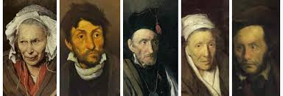
1.1.1.1.3 PSYCHOPATHOLOGICAL DIFFERENCES
CONSEQUENCES IN PSYCHOPATHOLOGY
VIEW OF THE ILL HUMAN BEING

Slide 14
FUNCTIONS
SUBFUNCTIONS
SYMPTOMS
1.3.3.1
ECLECTIC MODEL (MEDICAL)

Slide 15
ORIGIN OF SYMPTOMS ACCORDING TO THE ECLECTIC MODEL (medical-psychiatric)
They result from the summative connection of functions and subfunctions with each other

Slide 16
PSYCHOMOTOR
FUNCTION
AFFECTIVE AND
MOOD FUNCTION
COGNITIVE FUNCTION
SYMPTOMS
DISORDER

Slide 17
psychological factors
social factors
biological factors
1.3.3.2
INTEGRATED
STRUCTURAL
MODEL
(I.S.M.)

Slide 18
ORIGIN OF SYMPTOMS ACCORDING TO THE STRUCTURAL MODEL (I.S.M.)
They result from the connection of functions and subfunctions integrated with each other

Slide 19
FUNCTIONS
SUBFUNCTIONS
SYMPTOMS
INTEGRATED STRUCTURAL MODEL
(I.S.M.)

Slide 20
PURPOSE OF SYMPTOMS
COGNITIVE
FUNCTION(LANGUAGE)
MOOD/AFFECTIVE FUNCTION(LANGUAGE)
PSYCHOMOTOR
FUNCTION (LANGUAGE)
REGAIN STABILITY

Slide 21
1.4 THE RESULTING REHABILITATION MODELS
ECLECTIC MODEL (medical)
»SAFE FAILING MODEL»
INTEGRATED MODEL
(I.S.M.)
«RESTRUCTURING MODEL»
PSYCHOLOGICAL FACTORS
SOCIAL FACTORS
BIOLOGICAL FACTORS
PSYCHOLOGICAL FACTORS
SOCIAL FACTORS
BIOLOGICAL FACTORS

Slide 22
2.THREE PSYCOTIC PATIENS a common fate or the opportunity to change fate
TREATMENT EXPERIENCE WITHIN THE TWO MODELS

Slide 23
2.1 ANAMNESIS AND CLINICAL DESCRIPTION OF THE THREE PATIENTS
Presentation of the patients’ common history during the rehabilitation pathway called
«safe failing»

Slide 24
PATIENT 1
MATTEO
PATHOLOGICAL ANAMNESIS
ONSET 2011: DIAGNOSIS: MISSING
At the age of 21
AGITATION
HASHISH, MARIJUANA AND ALCOHOL-INDUCED EUPHORIA
DELUSION OF PERSECUTION AND OMNIPOTENCE
THERAPY: VALPROIC ACID 1200mg , RISPERIDONE 2mg, DIAZEPAM 10mg, RISPERIDONE 37.5mg
HOSPITALISATION AT PSYCHIATRIC DIAGNOSIS AND TREATMENT SERVICE

Slide 25
PT1
DIAGNOSIS
SYMPTOMS
THERAPY
Thought disturbance
Auditory hallucinations, panic attacks, substance use
Thought disturbances
Auditory disperceptions
Panic attacks
Social withdrawal
Hyperphagia
PERSECUTORY DELUSION
PERSECUTORY DELUSION
PSYCHOMOTOR AGITATION
HYPERPHAGIA
PANIC ATTACKS
PSYCHOMOTOR AGITATION
AGGRESSION
SOCIAL WITHDRAWAL
VALPROIC ACID 500mg
ARIPIPRAZOLE 30mg
LORAZEPAM 2.5mg
ARIPIPRAZOLE 30mg
VALPROIC ACID 1000mg
LORAZEPAM 2.5mg
ARIPIPRAZOLE 30 MG
VALPROIC ACID 1000mg
ARIPIPRAZOLE 30mg
LORAZEPAM 2.5mg
LATER REPLACEMENT OF ARIPIPRAZOLE WITH QUETIAPINE
ADDITION AND THEN DISCONTINUATION OF ESCITALOPRAM
ESK proposal
And CLOZAPINE
April, 2012: PSYCHOSIS NOT OTHERWISE SPECIFIED
From May 2013 to May 2014: PSYCHOSIS NOT OTHERWISE SPECIFIED
FROM 2014 TO 2017: PSYCHOSIS NOT OTHERWISE SPECIFIED
FROM 2017 TO 2019: PSYCHOSIS NOT OTHERWISE SPECIFIED
2019-2022 : CHRONIC TREATMENT-RESISTANT PSYCHOSIS

Slide 26
TO SUM UP
PT 1
DIAGNOSES
THERAPIES
-RISPERIDONE
-VALPROIC ACID
-DIAZEPAM
-ARIPIPRAZOLE
-ESCITALOPRAM
-PALIPERIDONE
-QUETIAPINE
-HALOPERIDOL
-OLANZAPINE
-LAMOTRIGINE
-CLOZAPINE
-Psychosis NOS - Substance-induced psychosis -Chronic treatment-resistant psychosis

Slide 27
PATIENT 2
LUISA
ONSET 1996 DIAGNOSIS: MISSING
AT THE AGE OF 18
Symptoms: generalised fear
psychomotor agitation
PHARMACOTHERAPY:
HALOPERIDOL AND FLUOXETINE
Until 2001 compensation (precarious) with mild anxiety.
In 2001 interruption of the pharmacotherapy. Regression crisis with hospitalisation at Psychiatric Diagnosis and Treatment Service.
From 2004 to 2007 drug-treated anxiety.
In 2008 first work experience. Anxiety and fear. 2008 prima esperienza lavorativa. Ansia e paura.

Slide 28
PT 2
DIAGNOSIS
SYMPTOMS
THERAPY
APRIL, 2014 : BIPOLAR DISORDER,
DEPRESSIVE PHASE
MAY, 2014: BIPOLAR DISORDER,
MILD MANIC EPISODE
MAY, 2016: BIPOLAR DISORDER,
MANIC PHASE WITH PSYCHOTIC SYMPTOMS
APRIL, 2017: SCHIZOAFFECTIVE
DELIRIOUS EPISODE
AUGUST, 2017: ANXIOUS-DEPRESSIVE STATE
IN SCHIZOAFFECTIVE DISORDER
SELF-HARMING IDEATION
MOOD DEFLECTION
SOCIAL WITHDRAWAL
LOSS OF APPETITE
THOUGHT ACCELERATION
DISPHORIC MOOD
PSYCHOMOTOR AGITATION
LOGORRHEA
INSOMNIA
DELIRIOUS IDEATION
DISPERCEPTIONS
DISPHORIA
LOGORRHEA
. INTERPRETATIVE IDEATION
NON-ACCEPTANCE OF THE DISORDER
DISPHORIA
RESTLESSNESS
DISTRESS
INCREASED ANXIETY
PANIC ATTACKS WITH SOMATISATION
ISOLATION
APPETITE LOSS
VALPROIC ACID 1000mg
HALOPERIDOL 10 DROPS 3 TIMES DAILY
DELORAZEPAM TABLETS 2mg
ARIPIPRAZOLE 10mg
VALPROIC ACID 1000mg
HALOPERIDOL 10 DROPS
DELORAZEPAM TABLETS 2mg
ARIPIPRAZOLE 400mg 1 VIAL ONCE MONTHLY
VALPROIC ACID 1200mg
RISPERIDONE 2mg
DIAZEPAM 10 DROPS AFTER 10 DAYS
RISPERIDONE 37,5mg EVERY 14 DAYS
VALPROIC ACID TABLETS 500mg TWO TIMES DAILY
DELORAZEPAM TABLETS 2mg
ARIPIPRAZOLE 400mg 1 VIAL ONCE MONTHLY
VALPROIC ACID TABLETS 500mg TWO TIMES DAILY
ARIPIPRAZOLE 400mg 1 VIAL ONCE MONTHLY

Slide 29
PATIENT 2
LUISA
TO SUM UP
DIAGNOSES
THERAPIES
FLUEXETINE
VALPROIC ACID
HALOPERIDOL
DELORAZEPAM
ARIPIPRAZOLE
MONTHLY
RISPERIDONE
DIAZEPAM
BIPOLAR DISORDER,
DEPRESSIVE PHASE
BIPOLAR DISORDER,
MILD MANIC EPISODE
BIPOLAR DISORDER,
MANIC PHASE WITH PSYCHOTIC SYMPTOMS
SCHIZOAFFECTIVE
DELIRIOUS EPISODE
ANXIOUS-DEPRESSIVE STATE IN SCHIZOAFFECTIVE DISORDER

Slide 30
PATIENT 3
LIA
ONSET 2017 DIAGNOSIS: MISSING
15 YEARS OLD
SYMPTOMS: RESTRICTED FOOD INTAKE LEADING TO SUBSTANTIAL WEIGHT LOSS (33kg)
THERAPY: MANDATORY MEDICAL TREATMENT REQUESTED BY FAMILY MEMBERS
AT THE AGE OF 12: BEGINNING OF RESTRICTED FOOD INTAKE AND SOCIAL INTERACTION DIFFICULTIES

Slide 31
PT 3
DIAGNOSIS
SYMPTOMS
THERAPY
Weight loss (31kg)
Fear of losing control
Weight loss
Social withdrawal
School dropout
Suicide attempt with drug abuse
Self-harm
Sexual promoscuity
Weight gain
Self-harm
Suicide attempt with drug abuse
Restricted food intake
Compulsive sport consumption
Panic attacks
Suicidial thoughts and plans
Suicide attempt with drug abuse
DELORAZEPAM
OLANZAPINE 5 MG
ESCITALOPRAM 10 MG
DURING INPATIENT TREATMENT FOR EATING DISORDERS
CLOMIPRAMINE 25 AND 75 MG
FLUVOXAMINE 100 MG
DELORAZEPAM
OLANZAPINE
Admission to ED and discharge with the following prescription:
QUIETAPINE 50 MG
FLUVOXAMINE 50 MG
During check-up therapy is improved with the addition of Vortioxetine 5 mg (refused by the patient)
Diazepam
Aripripazole 10mg
Delorazepam 2mg
Oxcarbazepine 300mg
Aripripazole 400mg 1 Fial once monthly
March, 2019: hospitalisation until August for nutrition and eating disorders
2020: hospitalisation for nutrition and eating disorders
2021: psychiatric disorder not otherwise specified
Anxiety disorder (admission to ED)
OCTOBER, 2021 – Hospitalisation at Psychiatric Diagnosis and Treatment Service
Borderline personality disorder with eating disorders and atypical depression

Slide 32
TO SUM UP
PT 3
DIAGNOSES
THERAPIES
Borderline personality disorder with eating disorders and atypical depression
-DELORAZEPAM
-OLANZAPINE
-ESCITALOPRAM
-CLOMIPRAMINE
-FLUVOXAMINE
-QUETIAPINE
-OXCARBAZEPINE
-ARIPRIPAZOLE MONTHLY

Slide 33
COMMON FATE
LUISA
24 YEARS OF MENTAL DISORDER
MATTEO
10 YEARS OF MENTAL DISORDER
LIA
7 YEARS OF MENTAL DISORDER
INITIAL DIAGNOSIS WITH MINOR SEVERITY INDEX
REDUCED OR DISCONTINUED PHARMACOTHERAPY UPON SYMPTOM REDUCTION
RELAPSE
AGGRAVATION
CHRONICISATION

Slide 34
THE VICIOUS CYCLE OF CHRONICISATION
onset
Pharmacotherapy
Symptom reduction
Pharmacotherapy reduction
Increased stimuli
Symptom increase
Aggravation of the disorder and change in diagnosis

Slide 35
2.1.1
DIAGNOSTIC MODELS
CAUSES
OF THE VICIOUS CYCLE
TYPES OF TREATMENT

Slide 36
2.1.1.1 DIAGNOSTIC MODELS

Slide 37
CATEGORIAL DIAGNOSTIC SYSTEM
FUNCTIONS
SUBFUNCTIONS
SYMPTOMS
Functions
Subfunctions
Symptoms
On the same logical level

Slide 38
DIAGNOSTIC MANUALS CATEGORIAL/DIMENSIONAL APPROACH
DSM
Diagnostic and Statistical Manual of Mental Disorders (American Psychiatry).
Reference document since 1958
It enables communication among professionals
It presents statistics
ICD
First version in 1900 in Paris.
It has become the international standard diagnostic classification of deseases. Adopted by WHO in 1990.
Its main purpose is to permit the systematic recording analysis, interpretation and comparison of data

Slide 39
DIAGNOSTIC MANUALS COMMON FEATURES
ALL SYMPTOMS ARE IDENTICAL
THEY ARE ANALYSED IN TERMS OF PRESENCE AND ABSENCE
NO IMPORTANCE IS PLACED ON FUNCTIONS IN THE DIAGNOSTIC PROCESS
THE INTEGRATION OF FUNCTIONS PLAYS NO ROLE IN THE FORMULATION OF THE DIAGNOSIS

Slide 40
2.1.1.2 TREATMENT

Slide 41
ECLETTISM = SUPPORT
SAFE FAILING MODEL
Pharmacotherapy
Sociotherapy
Psycho terapy
Reduction of symptoms and capabilities
Possible adaptation of reduced
capacities to problematic
social context
Support for reduction abilities

Slide 42
2.2
NEW HORIZONS IN PSYCHOSIS TREATMENT
FROM THE ECLECTIC VIEW TO THE STRUTUCTURAL VIEW:
Restructuring Model

Slide 43
2.2.1 Diagnosis according to the Integrated Struttural Model (I.S.M.): the actualisation of the Restructuring Model

Slide 44
INTEGRATED
STRUCTURAL
MODEL
(I.S.M.)
Cornerstone:
EPISTEMOLOGY
STRUCTURAL CONSTRUCTIVIST EVOLUTIONIST EMERGENTIST,
INTERSUBJECTIVE
Structural Costructivist
Reality is not given but constructed
Evolutionist Emergentist
From – (minus)goes to +(plus). For example: from non-life comes life
Intersubjective
Reality arises from the conscious encounter between two individuals

Slide 45
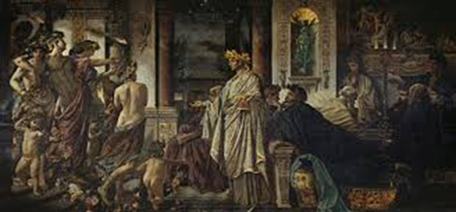
INTEGRATED STRUCTURAL MODEL Cornerstone: anthropology, psychopatohlogy, treatment
POSTULATES
LANGUAGE
INTEGRATION
DISSOCIATION
TREATMENT

Slide 46
LANGUAGE
Elements (syllables, words, sentences)
that coherently combined with each other (syntax)
acquire a meaning that can be conveyed verbally or non-verbally

Slide 47
POSTULATES
AUTOMATIC RULES CONCERNING WHAT AN INDIVIDUAL, A FAMILY, A CULTURE REGARD AS GOOD OR BAD, RIGHT OR WRONG THAT REMAIN UNCHANGED UNTIL THEY ARE MODIFIED THROUGH A FULLY ENGAGED PROCESS OF REFLECTION

Slide 48
INTEGRATION
Connection among coherent elements

Slide 49
DISSOCIATION
break in the connection caused by incoherence among elements

Slide 50
TREATMENT
Construction of the coherence necessary for the integration

Slide 51
4
LANGUAGES
Ra
RATIONAL/
COGNITIVE
Fa
FANTASY/
IMMAGINARY
Bd
BODY
E
EMOTIVE
THE 4 LANGUAGES OF EXISTENCE FORM THE INDIVIDUAL

Slide 52
Each Language is a grammar
Connotation
Denotation
Giving a name,
calling into existence
with a personal meaning
Make a personal judgement
Any denotation is a connotation and vice versa =
COESSENTIALITY

Slide 53
Languages of existence
BODY LANGUAGE
What can be perceived as a need expressed through
Motor Scheme
DENOTE
Bd
(body)
What the individual considers as
Dangerous:
- to avoid (Fear)
- to destroy (Anger)
Good:
- to be approached (Joy)
- sad to have lost (Sadness)
CONNOTE

Slide 54
THE PRIMARY ELEMENTS that construct bodily concepts/needs
NEEDS
PROPRIOCEPTION
BREATH
CONNECTION AMONG THE PARTS
MUSCULAR TONE
MUSCULAR TROPHISM

Slide 55
Languages of existence
EMOTIVE LANGUAGE
What can be perceived or expressed as Emotion:
fear, anger
joy, sadness
DENOTE
E
(emotions)
What the individual considers as
Dangerous:
- To avoid (Fear)
- To destroy (Anger)
Good:
- To be approached (Joy)
- Sad to have lost (Sadness)
CONNOTE

Slide 56
Languages of existence
FANTASY/IMAGINARY LANGUAGE
What can be stated subjectively
IMAGINATION, DREAMS, ANALOGICAL THINKING
FA
(Fantasy/
Imaginary)
What is subjectively perceived to exist
DENOTE
What is considered to be right/wrong
CONNOTE

Slide 57
Languages of existence
RATIONAL LANGUAGE
What can be said objectively RATIONAL THINKING
RA
(Rational)
What is perceived to exist
VERBAL DENOTATION
What can be right/wrong
VERBAL CONNOTATION

Slide 58
THE INDIVIDUAL
Ra
Fa
Bd
E
SUBJECTIVE GRAMMAR
Each of the 4 languages (grammars)
is integrated with the others
in order to build a
more complex
subjective grammar

Slide 59
Il
Higher logical level is the level of existential positions.
It allows us to describe the different ways in which the individual relates to others:
Child: indicates the position in which the individual pursues the fulfillment of his/her own needs
Parent: refers to the ability to encourage growth in the people you care about
Adult: encompasses the capacity to relate to others by giving equal dignity to oneself and to others; to act upon one’s own needs and respect for the outside world accordingly.
The healthy individual is capable of adjusting these positions to the stages of the life cycle and the relationships he/she builds up.
P A C
BO
E
FA
RA

Slide 60
EACH LANGUAGE CAN BE:
CONSCIOUS (REFLECTIVE) O UNCONSCIOUS (SPONTANEOUS)
}
- Unconscious level (Spontaneous) → Postures, needs and automatic gestures
- Conscious level (Reflective) $\text{→}$ Reflective knowledge of the needs
BODY LANGUAGE
EXAMPLE: TRANSITION FROM SPONTANEUS TO REFLECTIVE URINATION AND AGAIN TO A SPONTANEOUS HIGHER LOGICAL LEVEL

Slide 61
ANTHROPOLOGY OF THE INTEGRATED STRUCTURAL MODEL
SELF
INDIVIDUAL AS TOTALITY
EXISTENTIAL POSITIONS
P A C
LANGUAGES OF EXISTENCE
RINGS OF LIFE
SS SR EN IO CONT.
ACCORDING TO THE INTEGRETED STRUCTURAL MODEL (I.S.M.)
an individual is
LANGUAGE
that gives and receives meaning
TOTALITA’
ANELLI DELLA CATENA DELLA VITA
SS SR EN IOcont.
Simbolico Spontaneo/Riflesso
Intersoggettività
Evidenza naturale
BO
E
FA
RA

Slide 62
2.2.2 THE TREATMENT

Slide 63
Integration within community treatment settings THE CARING STAFF
Restructuring Rehabilitation
General Supervisor
Supervisor
Director of the community treatment centre
Psychotherapist
Pharmacotherapist
Sociotherapist
Students and Interns
Patients
CONGRUENCE
EMPATHY

Slide 64
TEAM SUPERVISION
Setting integration
I Setting
weekly
group
weekly
Individual
daily
Group
weekly
Family
High difficulty
Medium
Difficulty
Basic difficulty
Psychotherapy
GENERAL MONITORING
qualitative changes
quantitative changes
Sociotherapy
Pharmacotherapy
RESTRUCTURING REHABILITATION

Slide 65
INTEGRATION OF THE INTERVENTIONS
Psychotherapy
Pharmacotherapy
Socio
therapy
Environment that encourages/stabilises
awareness of strengths/weaknesses
Awareness of inappropriate subjective
view-points
Decision to change them
Pain reduction to foster disorder awareness and improve decision-making skills

Slide 66
LOGICAL LEVELS INVOLVED
RS/SS
EXISTENTIAL POSITIONS
LANGUAGES OF EXISTENCE
RS: REFLECTIVE SELF
SS: SPONTANEOUS SELF

Slide 67
1
STEPS IN THE RESTRUCTURING MODEL THERAPEUTIC PROCESS
DISORDER AWARENESS IN THE PATIENT
AWARENESS WITHIN THE FAMILY GROUP OF THE PATIENT’S DISORDER
DISORDER AWARENESS
AMONG FAMILY MEMBERS
PATIENT ENGAGEMENT AND AWARENESS OF THE PATIENT’S DISORDER (INDIVIDUAL-FAMILY)
DECISION TO ACCEPT TREATMENT

Slide 68
2
STEPS IN THE RESTRUCTURING MODEL THERAPEUTIC PROCESS
AWARENESS OF THE POSTULATES UNDERLYING THE RELATIONAL STYLES THAT ENSURE THE STABILITY OF THE PATIENT AND FAMILY (E.G. IDENTIFIED PATIENT OR SCAPEGOAT),
THE ABILITY TO BE ASSERTIVE,
THE CAPACITY FOR CLOSENESS AND
THE INTEGRATION AMONG THEM
DECISION TO MODIFY THEM

Slide 69
3
STEPS IN THE RESTRUCTURING MODEL THERAPEUTIC PROCESS
DIFFERENTIATION AMONG PATIENT’S JUDGEMENTS (=INDIVIDUAL-FAMILY)
PREMATURE TREATMENT TERMINATION
DECISIONS:
The individual and the family group make the same decision
The individual and the family group make different decisions
TREATMENT CONTINUATION
THE INDIVIDUAL AND FAMILY MEMBERS GO THEIR SEPARATE WAYS

Slide 70
PATIENT (INDIVIDUAL-FAMILY MEMBERS)
FAMIGLIA (i soggetti che la compongono)
COMMUNITY (the individuals who are part of it)
DECISION
=
MAJORITY RULE
PUBLIC MENTAL HEALTHCARE SERVICES

Slide 71
MATTEO’S THERAPEUTIC PATHWAY
From February 2022 ( still ongoing)

Slide 72
Phases of Matteo’s therapy
Disorder awareness in the patient
Disorder awareness among family members
Harmonizations of awarenesses in the patient, family and caring community

Slide 73
Matteo’s treatment
FAMILY PSYCHOTHERAPY
BODY
WORK
GROUP PSYCHOTHERAPY
ADVANCED LABORATORY
PSYCHOPHARMACOTHERAPY
INDIVIDUAL PSYCHOTHERAPY

Slide 74
COMMON GOALS IN ALL SETTINGS
CAPACITY FOR ASSERTIVENESS TO BUILD CLOSENESS
AWARENESS OF THE PRESENCE OF ANGER AND ABSENCE OF FEAR
AWARENESS OF THE FACTORS PREVENTING THE EMERGENCE OF FEAR
DECISION TO CONFRONT FEAR
AWARENESS OF THE FACTORS FACILITATING THE EMERGENCE OF FEAR

Slide 75
Supervisione Matteo Family psychotherapy
February 22

Slide 76
Family psychotherapy - February, 2022
PATIENT’S DISORDER AWARENESS IN THE PATIENT AND FAMILY MEMBERS
IDLE ADULT
FACTOR PREVENTING THE EMERGENCE OF FEAR
HYPERACTIVE CHILD
FACTOR FACILITATING THE EMERGENCE OF FEAR

Slide 77
Matteo’s exercises 1

Slide 78
March 2022
BODYWORK
1) Squat
2) Hand pushing against the wall
Chest stiffness
FACTOR PREVENTING THE EMERGENCE OF FEAR AWARENESS
Chest elasticity
FACTOR FACILITATING THE EMERGENCE OF FEAR AWARENESS

Slide 79
Individual psychotherapy - April 7th 2022
DISORDER AWARENESS IN THE PATIENT
TRANSITION FROM SYMPTOM TO RELATIONSHIPS (=PROBLEM)
Request to abandon the group = fear avoidance
FACTOR SUPPRESSING THE EMERGENCE OF FEAR
Decision to stay in the group = confrontation of fear
FACTOR EASING THE EMERGENCE OF FEAR
Feeling being analysed by people=persecution
Desire to build deeper connection with others

Slide 80
Family psychotherapy – June 2022
PATIENT’S DISORDER AWARENESS IN THE PATIENT AND AMONG FAMILY MEMBERS
OMNIPOTENCE
«there are no incurable mental disorders»
FACTOR BLOCKING THE EMERGENCE OF FEAR
HOPE FOR RECOVERY IN THE PATIENT
REALITY «I suffer from a serious mental disorder, who knows if I recover»
FACTOR FOSTERING THE EMERGENCE OF FEAR
HOPE FOR RECOVERY WITHIN THE FAMILY

Slide 81
Individual psychotherapy - September 22nd 2022
DISORDER AWARENESS IN THE PATIENT
TRANSITION FROM SYMPTOM TO RELATIONSHIPS
FACTOR PREVENTING THE EMERGENCE OF FEAR
Awareness of the fear of having relational experiences
FACTOR FACILITATING THE EMERGENCE OF FEAR
Delays at the secretariat services laboratory
Fear awareness
Emergence of sadness

Slide 82
Individual psychotherapy September 26th 2022
DISORDER AWARENESS IN THE PATIENT
TRANSITION FROM SYMPTOM TO RELATIONSHIPS
Unstable Delirium (=Progress rispect to stable delirium)
FACTOR SUPPRESSING THE EMERGENCE OF FEAR
Awareness of unwillingness to face fear
FACTOR FACILITATING THE EMERGENCE OF FEAR
Presence of odd thoughts «fantasizing»
Fear awareness

Slide 83
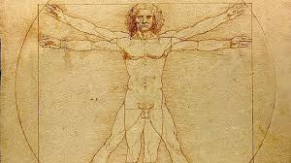
1) LYING DOWN
2) ABDOMINAL BREATHING
February 2023
BODY WORK
Chest stiffness
Abdominal tightness
Shortness of breath
FACTORS BLOCKING THE EMERGENCE OF FEAR
Chest elasticity
Abdominal elasticity
Need for deep breathing
FACTORS EASING THE EMERGENCE FO FEAR

Slide 84
GOALS OF THE LABORATORIES
PERSONAL CARE
BUILDING UP RELATIONSHIPS
RESUMING STUDIES
BEDROOM AND SURROUNDING ENVIRONMENT CLEANLINESS AND ORGANIZATION
SECRETARIAT SERVICES

Slide 85
DECISION
=
MAJORITY RULE
PATIENT (INDIVIDUAL-FAMILY MEMBERS)
FAMIGLIA (i soggetti che la compongono)
COMMUNITY (the individuals that are part of it)
PUBLIC MENTAL HEALTHCARE SERVICES

Slide 86
Goals of the restructuring rehabilitation achieved by Matteo
after 1 year
self-awareness and modification of one's view of oneself, the other and the world= awareness of being ill, decision to accept treatment and choice of the type of treatment (pharmacotherapy/psychotherapy/sociotherapy).
elimination of inpatient treatment (compulsory/voluntary).
elimination/reduction of symptomatology and pharmacotherapy
Transition to outpatient psychotherapy
Work and emotional independence.

Slide 87
THE CASE OF LUISA
september 2017

Slide 88
WHAT IS IMPORTANT TO THE PATIENT? FIGURE OUT LIMITATIONS AND INSTILL HOPE OF OVERCOMING THEM
PATIENT ENGAGEMENT

Slide 89
INDIVIDUAL PSYCHOTHERAPY
Luisa is a child to take care of and to reassure
She needs a point of reference(parent)
FAMILY
PSYCHOTHERAPY
Awareness within the family group of the patient’s disorder
Awareness of the family’s illness
GROUP
PSYCHOTHERAPY
Awareness of the relational style with peers
Experiencing the possibility of changing herself

Slide 90
SOCIOTHERAPY
LABORATORIES OF LOGIC: MATHEMATICAL AND LITERARY
GOAL: BUILDING THINKING SKILLS
LABORATORIES OF COOPERATION AND COLLABORATION
GOAL: CREATING THE APPROPRIATE DIFFICULTY WITH SUPPORT TO FOSTER RELATIONSHIPS AMONG PEERS OF BOTH SEXES

Slide 91
L
Pt 2
April 2018
Patient engagement
Disorder awareness

Slide 92
Disorder awareness
Awareness of limitations
Awareness of social interaction difficulties and dysfunctional Natural Necessity Postulates (NNP): "I am a Princess".
Emotional management, in particular ANGER AND FEAR (work on assertiveness)

Slide 93
April 2018
Boosting disorder awareness through body-oriented interventation

Slide 94
You are not a princess
Increased fear and anger
Effects of bodywork on disorder awareness
April 2018
Congruency
Denial: I am not mentally ill
Awareness: I have a mental disorder, I can face my disorder, I can recover

Slide 95
April 2018
AWARENESS
AND
DECISION

Slide 96
Faced with a choice
Individual with limitations who needs to stimulate her personal growth.
Increased support
Still being an omnipotent princess

Slide 97
DECISIONE
Through empathic congruence and assertiveness building support, the patient comes to the following decisions:
Growing as an autonomous and responsible person
Restructuring dysfunctional Natural Necessity Postulates (NNP)for a healthy growth

Slide 98
June 2019
Meeting with the psychiatrist of the public mental healthcare service.
Decision of the Local Health Authority (public mental healthcare service) to prematurely discontinue the psychorehabilitative treatment.
Dissociation from anger and convergence of joy/fear
Letter to the Local Health Authority

Slide 99
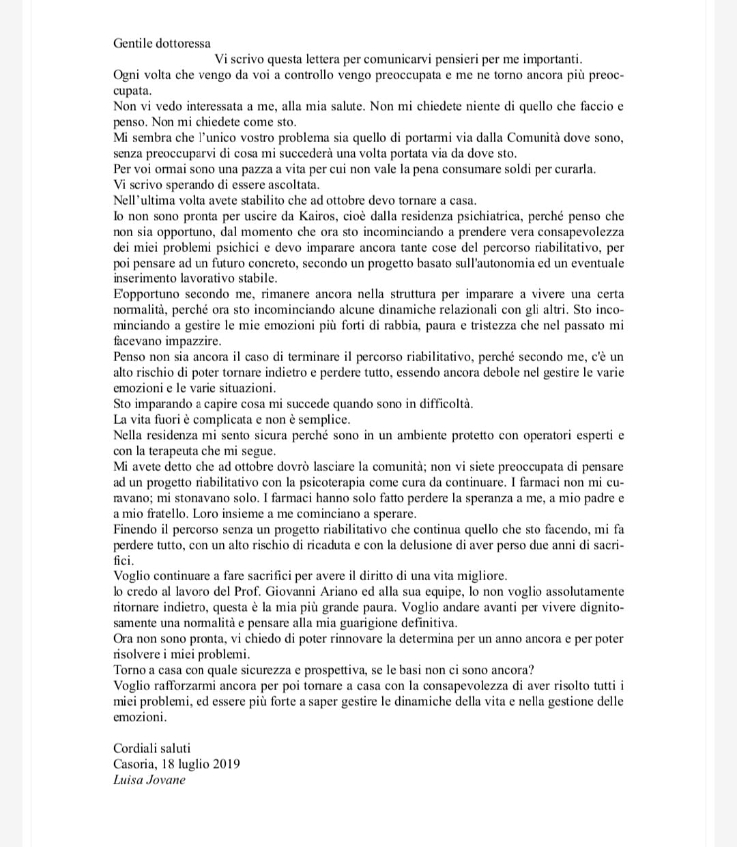
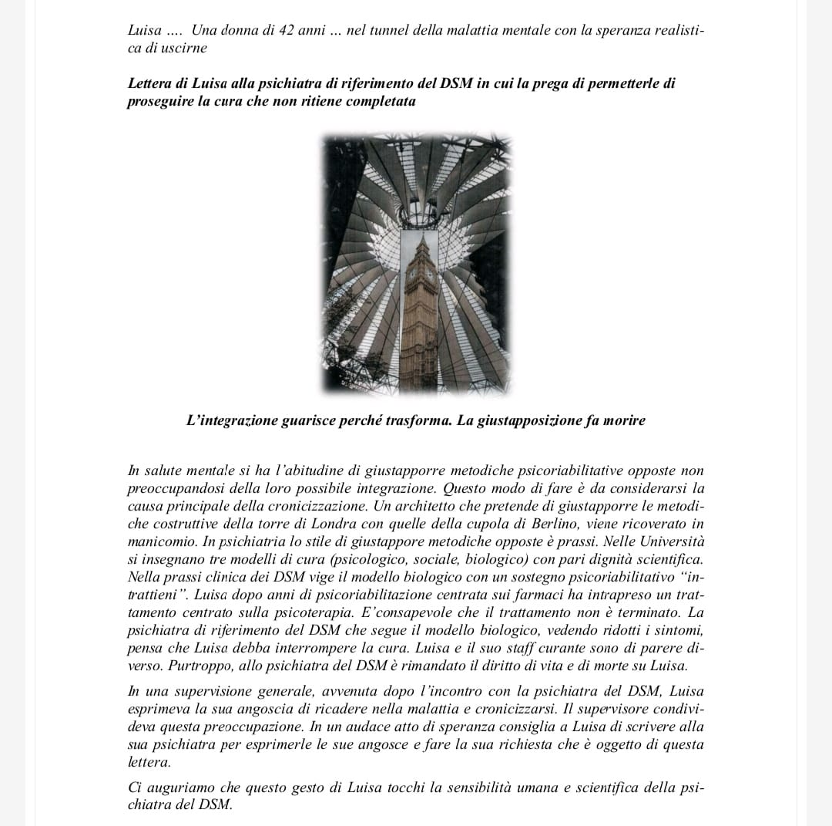
Letter to the Local Health Authority

Slide 100
In her letter to the Local Health Authority Luisa complains about the psychiatrist’s attitude. After each check-up Luisa gets more and more worried about herself and the doctor does not seem to care much about her health, feelings and thoughts as well as the activities she engages in. According to Luisa, the doctor is convinced that she will never recover from her mental illness and it is not worth investing public funds in her treatment at the psychiatric facility. Furthermore, the doctor did not conceive a concrete rehabilitation plan to be carried out after leaving the facility. Then, Luisa stresses how paramount is to her to continue the treatment. In fact, she has been benefiting from the therapeutic pathway in terms of disorder awareness, emotional management and relational experiences and this has instilled hope in herself and family members; however, she still needs support for a complete recovery and she fears that a premature treatment termination without an alternative rehabilitation plan could lead to a total or partial loss of the progress she has made so far.

Slide 101
DECISION
=
MAJORITY RULE
PATIENT: INDIVIDUAL AND FAMILY
FAMIGLIA (i soggetti che la compongono)
PUBLIC MENTAL HEALTHCARE SERVICES
CARING COMMUNITY

Slide 102
Decision to continue treatment against Local Health Authority’s advice (October 2019)
Supporting Rehabilitation:
Losing progress made so far
Restructuring Rehabilitation: fostering patient’s autonomy
The patient decides to carry on with the restructuring pathway.
The Local Health Authority (public mental healthcare service) interrupts the psychorehabilitative treatment.
The COMMUNITY continues treatment for free as long as possible

Slide 103
ACHIEVED GOALS
1) modification of one's view of oneself, the other and the outside world= awareness of being ill, decision to accept treatment and choice of the type of treatment (pharmacotherapy/psychotherapy).
2) elimination of inpatient treatment (mandatory/voluntary)
3) reduction of symptomatology
4) reduction of pharmacotherapy
(3 drops tid clotiapine)
5) In dispute with the Local Health Authority

Slide 104
June 2021
Premature discharge requested by the Local Health Authority
L. is discharged in June 2021
She attends biweekly individual psychotherapy
She works as secretarial assistant
She has an age-appropriate social life

Slide 105
Psychotherapy
Pharmaco therapy
Socio
therapy
In 2022
Interruption of family psychotherapy by choice of the brother and the father.
Loss of integration among interventations.
The patient is not sufficiently autonomous from family members

Slide 106
DECISION
=
MAJORITY RULE
PATIENT:INDIVIDUAL AND FAMILY
FAMIGLIA (i soggetti che la compongono)
PUBLIC MENTAL HEALTHCARE SERVICES
CARING COMMUNITY

Slide 107
LUISA
TODAY
BACK TO THE VICIOUS CYCLE

Slide 108
THE VICOUS CYCLE OF CHRONICISATION
Pharmacotherapy
Symptom reduction
Pharmacotherapy reduction
Stimuli increase
Symptom increase
Aggravation of the disorder and change in diagnosis

Slide 109
THE CASE OF LIA
A 21-year-old woman
PREVIOUS DiagnosES BASED ON DSM:
Borderline Personality Disorder
Eating disorders
Atypical depression
Given to non-consensus, photos and videos are missing. The name is fictional

Slide 110
Treatment: Phase 1-2
DISORDER AWARENESS
D
E
C
I
S
I
O
N
ENGAGEMENT
RULES
AWARENESSES

Slide 111
INTEGRATED INTERVENTATIONS
RESTRUCTURING PSYCHOTHERAPY
(individual, family, group setting )
BODYWORK
PSYCHOPHARMACOTHERAPY
INTERNAL MEDICINE INTERVENTIONS (not necessary)
SOCIOTHERAPY
Participation in laboratories with basic (personal care, surrounding environment cleanliness and organization) and medium difficulty (maths)

Slide 112
When PROPRIOCEPTIVE sensations emerge, they are VENTED, AVOIDED AND CONTROLLED BEFORE THEY BECOME CONCEPTS
The disease of the pATIENT is THE FEAR OF THE EMERGENCE OF BODY CONCEPTS = FEAR OF THE BODY. THE CONSEQUENCES ARE OMNIPOTENCE AND LIMITLESSNESS
TREATMENT:
EMERGENCE OF BODY CONCEPTS = EMERGENCE OF THE SENSE OF LIMIT
ENDURE THE RESULTING DISTRESS

Slide 113
Integrated psychotherapeutic treatment: setting level
INDIVIDUAL: CONSTRUCTION OF THE SENSE OF LIMIT
engagement = from control to the agreement on control
Relational rules = from egocentrism to the existence of You
FAMILY
GROUP

Slide 114
Integrated psychotherapeutic treatment: setting level
INDIVIDUAL
FAMILY
GROUP: CONSTRUCTION OF THE SENSE OF LIMIT
- Engagement: discussion with other patients of the psychiatric facility aimed at building disorder awareness (I am a mentally ill person among mentally ill people)
- Shared relational rules of space and time (relational rules between peers and no peers = respect for the roles)

Slide 115
LIA’S FAMILY (the individuals who are part of it)
Dominant
M - D1ip.
Recessive
F - S2
RIGID
Oppositional homeostatic equilibrium

Slide 116
Integrated psychotherapeutic treatment: setting level
INDIVIDUAL SETTING
FAMILY SETTING:
1) Building the stable system to work on
2) Awareness of the patient’s disorder within family members:
- F and D2 (= recessive subsystem) with greater awareness (=capability)
and less power
-M and IP (= dominant subsystem) with greater omnipotence, power and low awareness (=capability)
GROUP SETTING

Slide 117
INTEGRATED PHARMACOTHERAPY: required modifications in accordance with the therapeutic process
Aripiprazole 20mg daily
(EXCESSIVE COGNITIVE, AFFECTIVE, PSYCHOMOTOR FUNCTION → REDUCTION
Oxcarbazepine 450mg daily (EXCESSIVE PSYCHOMTOR FUCNTION → REDUCTION)
Delorazepam 6mg daily (EXCESSIVE AFFECTIVE FUNCTION → DISTRESS REDUCTION)
Aripiprazole monthly vial 400mg
Aloperidole 10 mg daily
(WEAKER BUT STILL DOMINANT COGNITIVE FUNCTION → REDUCTION OF THOUGHT RIGIDITY)
Clotiapine 5 mg daily (EXCESSIVE AFFECTIVE AND PSYCHOMOTOR FUNCTIONS → REDUCTION)
Discotninuation of benzodiazepine, oxcarbazepine, aripiprazole
gradually
PHARMACOTHERAPY DURING RESTRUCTURING TREATMENT =
ACTION ON INTEGRATED FUNCTIONS
PHARMACOTHERAPY BEFORE RESTRUCTURING REHABILITAION =
ACTION ON FRAGMENTED FUNCTIONS

Slide 118
Treatment: Phase A
DISORDER AWARENESS
D
E
C
I
S
I
O
N
RULES
Reaching the possible agreement to enter into a relationship: There is not only you, we both exist with different roles
Disorder Awareness at the level of LANGUAGES: cognitive, emotional and body
1) Symptoms: Increased control over weight and nutrition, self-harm, suicidal threats 2)DISTRESS, reduced control and self-induced vomiting to relieve tension
AWARENESS PHASE 1-2
Lia is on the fence whether to continue or interrupt treatment
ENGAGEMENT
Figure out what is important to the patient: maintaining control (=only I exist)

Slide 119
THE PATIENT'S DISORDER IS BEING THE ENEMY OF HER OWN BODY: IT IS A FEARFUL LANGUAGE THAT HAS NO CONCEPT FOR HER
Lia has to become aware that she cannot say what she wants because it is in the body that the needs she is afraid of arise; she will have to learn to sense (=dread less) her body in order to understand its desires
She will finally have to learn how to fulfil her own desires in her relationship with others without blackmailing them (=Emergence of You as Individual).

Slide 120
INTEGRATION OF THE DECISIONS
CARING STAFF: disagree with treatment discontinuation due to the severity and dangerousness of the patient
FAMILY: the recessive F-d2 subsystem does not support the patient's decision; the dominant M - Ip subsystem thinks about treatment termination and wants to take over. The family opts for treatment termination
Lia: the patient goes for premature treatment termination
GOAL of the first phase of the restructuring rehabilitation:
Increased disorder awareness
DECISION

Slide 121
DECISION
=
MAJORITY RULE
PATIENT (INDIVIDUAL-FAMILY MEMBERS)
FAMIGLIA (i soggetti che la compongono)
COMMUNITY (the individuals who are part of it)
PUBLIC MENTAL HEALTHCARE SERVICES

Slide 122
A few weeks after discharge the patient was admitted to another facility under voluntary medical treatment.

Slide 123
DIFFERENT FATE FOR DIFFERENT CHOICES
LUISA AND LIA
ARE BACK TO THE VICIOUS CYCLE
MATTEO
CONTINUES HIS TREATMENT

Slide 124
THANKS FOR YOUR ATTENTION

